Slide 1
San Benito County Broadband Strategic Plan Final Project Presentation
Prepared for San Benito County
December 5, 2023

Slide 2
San Benito County Broadband Strategic Plan
1
Review Scope & Timeline
2
FCC/CPUC Maps – Service Availability & Key Takeaways
3
Digital Equity Insights
4
Network Solutions & Scenarios Analysis
5
Recommended Scenarios & Key Takeaways
6
Broadband Policy Review
7
Action Plan

Slide 3
Project Scope & Timeline
This RCRC-funded project seeks to prepare the County for a broadband future via a countywide strategy and plan.
Data collected will support the County and other jurisdictions to continue to plan and apply for broadband funding.
Stakeholder outreach
Broadband Benefits Analysis
ISP Engagement Preparation
Network solutions design
Operating Model Assessment
Recommendations and next steps
Final Report & presentation
March / April
July / August
September / October
May / June
August / September
Data collection & Public forums
Broadband Needs Assessment
Smart Community Applications
Funding Sources Assessment
Broadband Policy Review

Slide 4
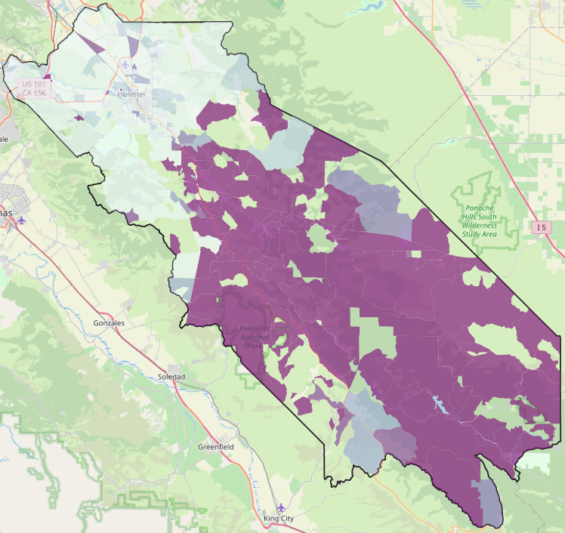
Broadband Service Status: FCC Data
Serviceable Location Status in San Benito
Unserved locations of San Benito exist in the unincorporated areas (Census block level)
1G Served Locations*
(> 1000/500)
1,206 | (6.5%)
Served Locations
(100/20 to 1000/500)
16,507 | (88.9%)
Underserved Locations
(25/3 to 100/20)
12 | (0.1%)
Unserved Locations
(< 25/3)
847 | (4.6%)
<1%
1% - 20%
20% - 40%
40% - 60%
60% - 80%
80% - 100%
18,572
*On July 15, 2022 the FCC launched a “Notice of Inquiry” that proposes to set a separate national goal of 1 Gigabit per second (Gbps)/500 Mbps for the future

Slide 5
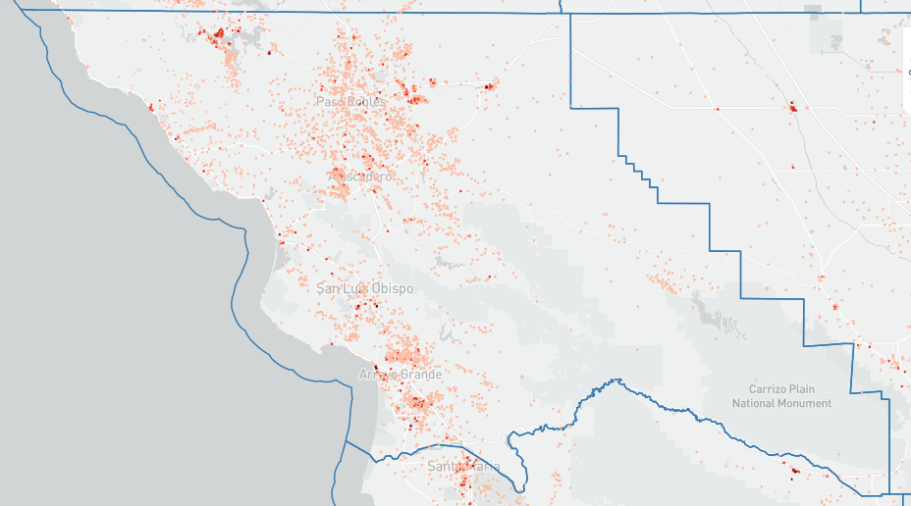
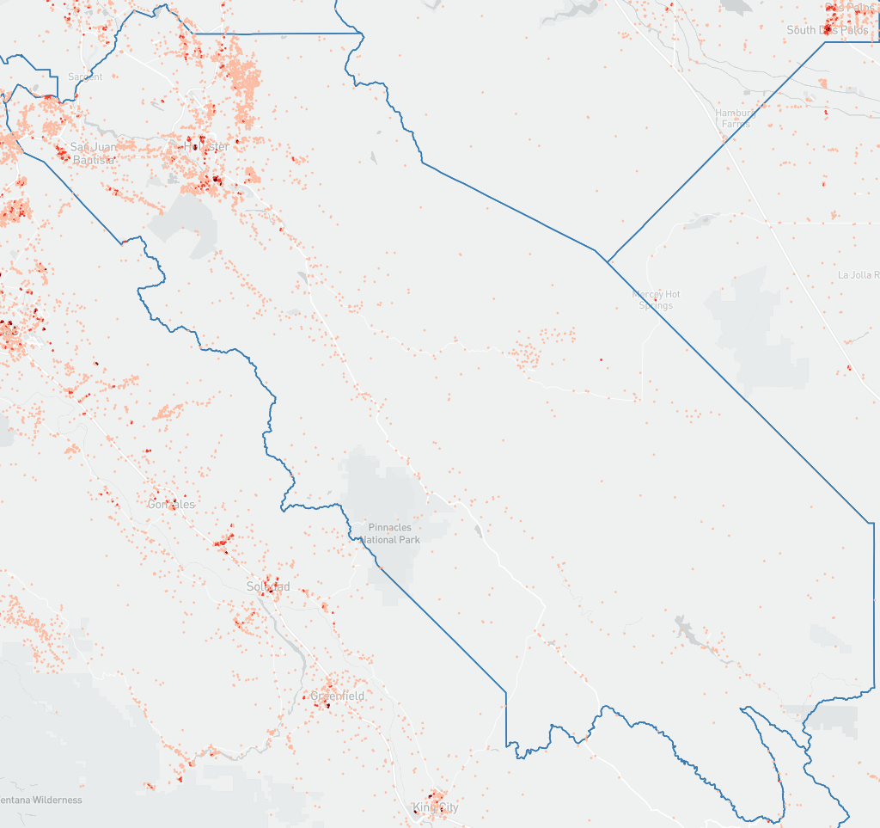
Broadband Service Status: CPUC Data
Unserved locations according to the CPUC FFA Public Map are captured below
Served Locations
15,336 | (78.9%)
Unserved Locations
4,098 | (21.1%)
1 - 2 unserved locations
3 - 10 unserved locations
>10 unserved locations
*For San Benito County, the CPUC FFA public map has significant variations with the FCC Broadband Map Dataset

Slide 6
San Benito Service Availability: Key Takeaways
95% of San Benito locations are considered served according to FCC (79% according to CPUC)
Of those served, 99.9% have access to speeds higher than 100/20 Mbps (FCC data)
Countywide View
80% of unserved locations are in unincorporated areas
Aromas, Ridgemark, and Tres Pinos are “well served” (>100/20) but lack 1G/500 Mbps service.
93% of the unincorporated unserved locations are in remote areas of San Benito County
Unincorporated Areas
93.5% of SB County locations lack access to 1G/500 Mbps service, leaving much work to be done
1G Service
Gap
*FCC data was utilized for analysis to take advantage of the necessary granularity (e.g., download/upload speeds, ISP, technology)

Slide 7
Digital Equity Insights
Digital Equity key learnings and insights are summarized below
Digital Equity Barriers
Digital Equity Programs
52% of households (7,723) are Eligible for the ACP.
Only 32.5% of those eligible (2,513) are enrolled
Updated with November data.
Promote ACP enrollment.
Affordability
Topography is an issue for infrastructure including areas that lack 911 access.
Traditional satellite service is ineffective and unstable.
Programs and partnerships to distribute computers, hotpots and Computer literacy workshops (e.g., The Loaves, Fishes and Computers program).
Track priority project opportunities via community partners.
Alliance on Aging as a partner support distribution of digital literacy information and ACP enrollment.
Free online programs within the library system to improve digital literacy
Availability
Aging population are digitally isolated.
Potential loss of jobs.
Skills
According to Census data, 96.3% of San Benito households have a computer at home.
Library system received 10k Chromebook and hotspots but lacked key partners to distribute.
Devices and Applications

Slide 8
Network Solutions & Scenario Analysis
Towards a Countywide Broadband Strategy
Identify Broadband Opportunity Zones
Develop Conceptual Designs
Assess Operating Models
Identify areas of need matched with revenue opportunities for ISP investment or PPP
Establish the potential solution (Fiber or FWA) for each area based on size, density and existing competition
Fiber and FWA conceptual design
Leverage GSN and existing municipal infrastructure
Cost estimate
Identify ongoing initiatives
Assess Funding Sources
Identify potential partners
High level business case
Match broadband projects with Operating Models

Slide 9
Recommended Scenarios: Key Takeaways
The proposed scenarios for the 9 broadband opportunity zones reduce unserved locations and increase 1G service from 6.5% to 83%
Satellite is required for ~330 unserved locations
Current​
Target
Total Grants amount
$18,447,980 total grants to enable 2 Fiber and 3 FWA projects
1G Served
1,206 (6.5%)
15,503 (83%)
16,507 (89%)
2,732 (15%)
Existing
Infra
6 Projects to leverage the California MMBI (GSN)
1 Project to use the existing Municipal Fiber Infra
Served
Underserved
12 (0.1%)
337 (1.8%)
Middle Mile
Additional investment in middle mile is required to enable two projects in remote areas: Southern Cluster and Hernandez Reservoir
Unserved
847 (4.6%)
0
(0%)
Satellite
Satellite as the solution for 337 unserved locations
Service > 25/3 Mbps for $70 to $75 (ACP eligible)
18,572

Slide 10
Broadband Policies
Broadband readiness for the County and the Cities that responded to the Data Collection request was performed based on the California Local Permitting Playbook and NTIA best practices
Readiness Assessment
Recommendations
San Benito County
SJB
City
Hollister City
Construction standards
Develop broadband construction standards and make them available online.
Permitting process Documentation
Document Permitting process (Cities)
Specify timelines for permitting (Cities)
Differentiation between major and minor broadband projects
Establish guidelines to classify and handle minor and major broadband permits
Not Broadband Ready
Broadband Ready

Slide 11
Broadband Policies
Readiness Assessment
Recommendations
San Benito County
SJB
City
Hollister City
Batch permitting process
Establish rules and processes for batch permitting
Permitting process Documentation
Leasing of public assets
Inventory of public assets
Provide guidance, rules, and fees to lease public assets (e.g., existing conduit, poles, towers) on Municipal websites.
New Assets Policies
Dig Once / Open Trench Policies
Enforce conduit deployment for major construction projects
Public GIS datasets
Create (Hollister) / improve (SBC & SJB) GIS Portals with broadband data
Serviceability, ongoing initiatives, existing infra, zoning, etc.

Slide 12
Action Plan
Permitting Process Updates & Documentation
Assess & Confirm GSCA Opportunity Zones
Public-Private Partnership Framework
Broadband Policy
Public GIS Broadband Portals
Partner Engagement & RFCP
Broadband Infrastructure
ACP Enrollment Promotion
Grants Monitoring & FCC Dataset Challenge
Digital Equity
Device Distribution & Digital Navigator Programs
Digital Literacy Programs from the Library System

Slide 13
www.teleworx.com

Slide 14
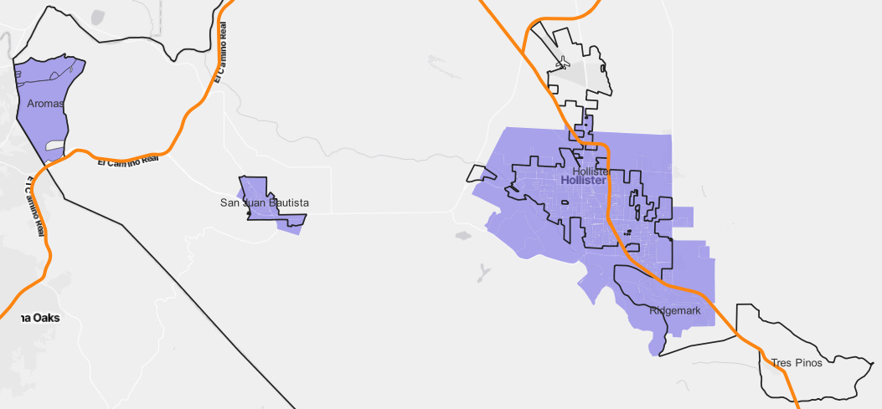
Broadband Opportunity Zones: Map View (1/3)
Fiber
Aromas
2% w fiber
267 location/sq mile
Hollister
7% w fiber
682 location /sq mile
FWA
C
GSN
B
A
San Juan Bautista
0% w fiber
527 location /sq mile
Opportunity Zones:
Middle-Mile:

Slide 15
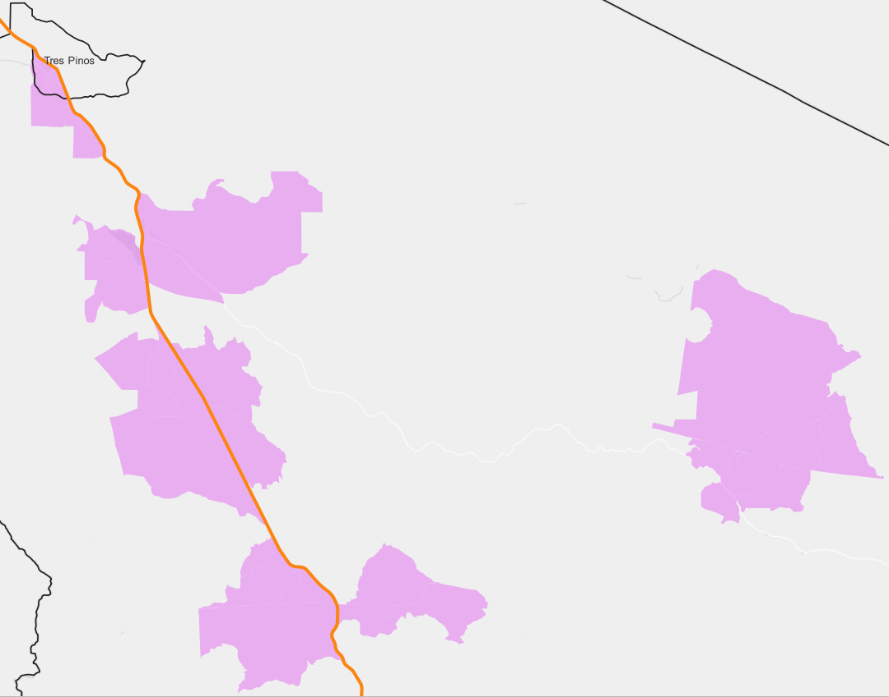
Broadband Opportunity Zones: Map View (2/3)
South Tres Pinos
0% w fiber
46.7 location /sq mile
A
Southern Cluster
0% w fiber
7.1 location /sq mile
Paicines
0% w fiber
8.7 location /sq mile
B
Scheid Vineyards
0% w fiber
6.7 location /sq mile
C
D
Willow Creek
0% w fiber
6.6 location /sq mile
Fiber
E
FWA
GSN
Opportunity Zones:
Fiber
FWA
Middle-Mile:
GSN

Slide 16
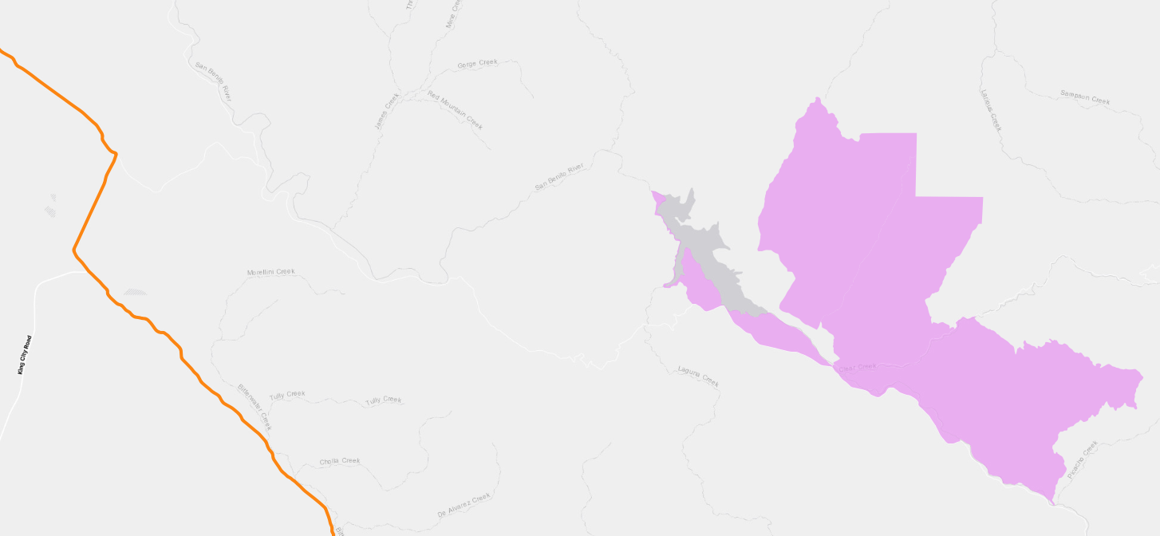
Broadband Opportunity Zones: Map View (3/3)
Hernandez Reservoir
0% w fiber
5.2 location /sq mile
F
Opportunity Zones:
Fiber
FWA
Middle-Mile:
GSN

Slide 17
Fiber Opportunity Zone Prioritization
Low
Feasibility & Timeframe
High
Operating Models
Phase 1
(2023-2024)
Phase 2
(2025-2026)
Long Term
(post-2026)
GSCA
(To be confirmed)
High density; GSN proximity; FFA funded
Hollister
Aromas
Fiber ISP standalone or PPP
(To be confirmed)
High density; Light competition; Pending CASF grant
San Juan Bautista
FWA ISP standalone or PPP
Grant eligible; positive or breakeven business case
< 100 locations; heavy middle mile investment
South Tres Pinos
Paicines
Willow Creek
Hernandez Reservoir
Scheid Vineyards
Southern Cluster
Low Location Count
High Location Count

