Slide 1
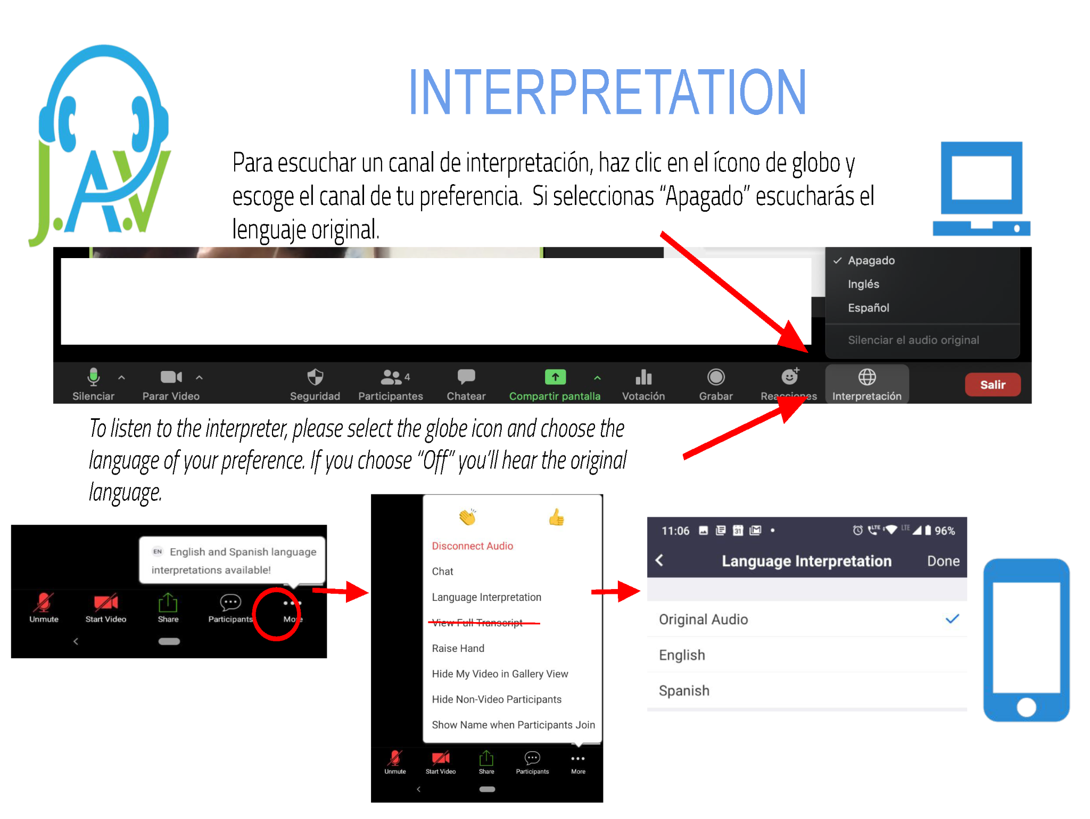
J.A.V. Language Solutions LLC, Certified Court & Healthcare Interpreter Ana Rueda de Vidales
Notes:
2 mins interpretation 6:02
1 min agenda overview 6:03
3-5 mins Dirks 6:08
3-5 mins Gary 6:13
7-10 mins MBEP 6:23
12-15 mins SBCOG 6:38
6 mins SBC 6:44
10 mins Q&A (2-3 Questions) 7pm

Slide 2
San Benito County Housing Element Workshop
Taller del Elemento de Vivienda del Condado de San Benito
September 29, 2022
Notes:
Good evening and welcome everyone. We are getting ready to get started, but first I would like to introduce you all to Ana Rueda de Vidales, our Interpreter from JAV Language Services LLC. She will take the stage to give everyone details on accessing interpretation services today.
2 mins interpretation
3-5 mins Dirks
3-5 mins Gary
1 min agenda overview
7-10 mins MBEP
12-15 mins SBCOG
6 mins SBC
10 mins Q&A (2-3 Questions)

Slide 3
Agenda
Welcome | Bienvenida
Presentation | Presentación
Questions & Answers | Panel de Discusión
Survey| Encuesta
Thank you! | ¡Gracias!
County of San Benito, Supervisor Betsy Dirks - Welcome / Bienvenida
Community Foundation for San Benito County, President / CEO - Gary Byrne - History of the Epicenter & Adjoining Housing / Historia del Epicenter y Viviendas Anexas
Monterey Bay Economic Partnership, Director of Strategic Initiatives - Housing & Broadband, Alyssa Kroeger - Facilitator / Facilitadora
Notes:
Presenters:
Monterey Bay Economic Partnership, Director of Strategic Initiatives, Alyssa Kroeger
Monterey Bay Economic Partnership, Housing and Sustainability Policy Manager, Elizabeth Madrigal
Council of San Benito County Governments, Transportation Planning Manager Veronica Lezama
County of San Benito, Assistant Director of Planning, Building & Code Enforcement Abraham Prado

Slide 4
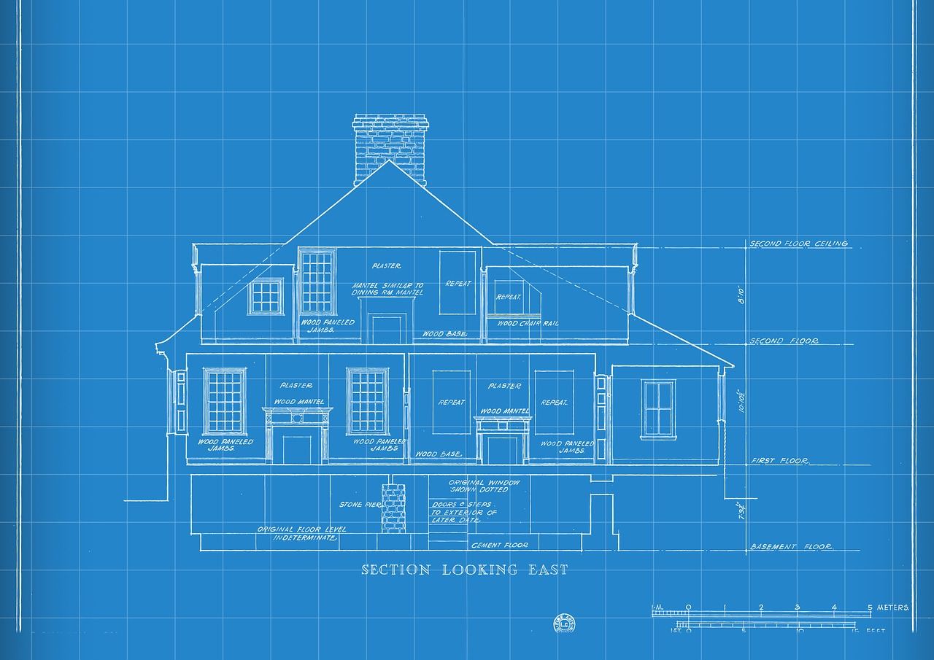
What is a Housing Element?
¿Qué es un Elemento de Vivienda?
Blueprint for how a city will meet its housing needs over the next 8 years
Plan de cómo una ciudad satisfará sus necesidades de vivienda en los próximos 8 años
Notes:
Required by state law
Existing and projected housing needs
Plan for homes needed in a community
Clearly defined policies, programs and objectives to meet housing need
Can set the foundation of when, where and how housing for all income levels can occur

Slide 5
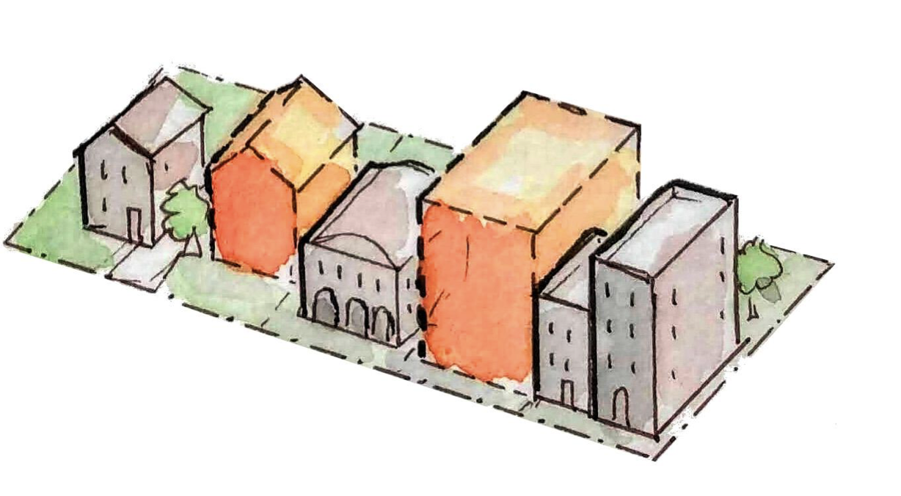
Why does the Housing Element matter?
¿Por qué es importante el Elemento de Vivienda?
Housing Elements grant communities the opportunity to:
Be involved
Affordable Housing Production
Affordable Housing Preservation
Tenant / Community Protection
Address the climate crisis
Los Elementos de Vivienda otorgan a las comunidades la oportunidad de:
Estar involucrado
Producción de Vivienda Asequible
Preservación de viviendas asequibles
Protección de la comunidad e Inquilino
Abordar la crisis climática

Slide 6
Affirmatively Furthering Fair Housing (AFFH): What Is It?
Promoción Afirmativa de Vivienda Justa (AFFH): ¿Qué es?
AB 686, Santiago (2018)
Combat housing discrimination, eliminate racial bias, undo historic patterns of segregation, and lift barriers that restrict acess in order to foster inclusive communities and achieve racial equity, fair housing choice, and opportunity for all Californians.
Combatir la discriminación en la vivienda, eliminar los prejuicios raciales, deshacer los patrones históricos de segregación y eliminar las barreras que restringen el acceso para fomentar comunidades inclusivas y lograr la equidad racial, la elección de vivienda justa y oportunidades para todos los californianos.
Notes:
Effective January 1, 2021 → All Association of Monterey Bay Area Government (AMBAG) jurisdictions must submit elements that seek to affirmatively further fair housing by December 2023
Monterey, Santa Cruz, and San Benito Counties, and all cities therein

Slide 7
Draft 6th Cycle Housing Unit Allocations by Jurisdiction
Proyecto de asignación del sexto ciclo de RHNA por jurisdicción
Notes:
Effective January 1, 2021 → All Association of Monterey Bay Area Government (AMBAG) jurisdictions must submit elements that seek to affirmatively further fair housing by December 2023
Monterey, Santa Cruz, and San Benito Counties, and all cities therein

Slide 8
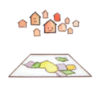
Milestones | Hitos
Fall
Fall
Fall
Dec
Ongoing
Ongoing
2021
2022
2023
2024 Onward
Step 1:
Regional Housing Needs Determination (RHND)
Step 2:
Regional Housing Needs Allocation (RHNA)
Step 3.1:
Housing Element Prep & Public Participation
Step 3.2:
Housing Element Submission Deadline
Step 4:
Housing Element Enforcement
Step 5:
Legislative Fixes
Note: Timeline is specific to SBCOG and HCD’s Schedule

Slide 9
Next Steps | Próximos Pasos
Engagement Opportunities
Housing Element Best Practices White Paper
Technical Assistance
Update our White Paper on Realistic, Short Term Policy Changes
Track and Support State Legislation
Oportunidades de Participación
Documento Político de Prácticas Mejores del Elemento de Vivienda
Asistencia Técnica
Actualizar Nuestro Documento Político Sobre Cambios de Política Realistas a Corto Plazo
Seguimiento y Apoyo a la Legislación Estatal
Notes:
Make sure to say that we’ll hear from our panelists on some examples of what is being done on this front [best practices] locally and to shout out our best practices paper coming later this year.
prepare to update their respective housing elements
Organize regional workshops with local advocates in the tri-county region;
Develop a Housing Element Best Practices White Paper to provide technical assistance to Monterey Bay jurisdictions
Update our White Paper on Realistic, Short Term Policy changes that local governments can implement to help achieve their RHNA goals.
Track and support state legislation that will help achieve RHNA goals.

Slide 10
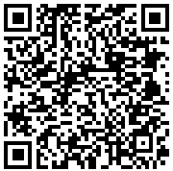
Survey Code | Código de Encuesta
Notes:
Presenters:
Monterey Bay Economic Partnership, Director of Strategic Initiatives, Alyssa Kroeger
Monterey Bay Economic Partnership, Housing and Sustainability Policy Manager, Elizabeth Madrigal
Council of San Benito County Governments, Transportation Planning Manager Veronica Lezama
County of San Benito, Assistant Director of Planning, Building & Code Enforcement Abraham Prado

Slide 11
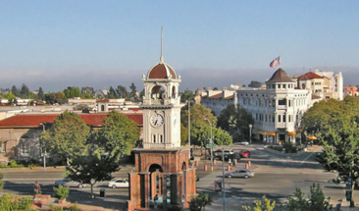
THANK YOU
GRACIAS

Slide 21
Best Practices for Community Engagement Las mejores prácticas para la participación de la comunidad
September 29, 2022
Prepared By: Abraham Prado

Slide 22
Public Participation in the Housing Element Update Participación pública en la actualización del elemento de vivienda
Purpose: To provide the community the opportunity to define housing issues and support in creating solutions.
Propósito: Para ofrecerle a la comunidad la oportunidad de definir problemas de vivienda y apoyo en la creación de soluciones.
Benefit: Increases the likelihood that community members will support new housing strategies and developments.
Beneficio: Aumenta la probabilidad de que los miembros de la comunidad apoyen nuevas estrategias y desarrollos de vivienda.

Slide 23
Public Participation in the Housing Element Update Participación pública en la actualización del elemento de vivienda
Plans for community engagement:
Bi-lingual Housing element workshops
Farmers markets
Other local events and gatherings
Visit local neighborhoods
Interactive survey
Interactive map for housing development
Planes para la participación comunitaria:
Talleres de elementos de vivienda bilingües
Mercados de agricultores
Otros eventos y reuniones locales
Visitar vecindarios
Encuesta interactive
Mapa interactivo para el desarrollo de viviendas
Who participates:
Community stakeholders
Residents
Elected officials
Community based organizations
Development and finance professionals
Quien participa:
Partes interesadas de la comunidad
Residentes
Oficiales electos
Organizaciones comunitarias
Profesionales del desarrollo y las finanzas.

Slide 24
Public Participation in the Housing Element Update Participación pública en la actualización del elemento de vivienda
Outreach methods:
Flyers with bilingual information at stores
Public Service Announcements (KMPG)
Social Media – Dedicated webpage
Staff being actively involved in the Community
Métodos de alcance:
Volantes con información bilingüe en tiendas
Anuncios de servicio público (KMPG)
Redes Sociales – Página web dedicada
Personal que participa activamente en la comunidad

Slide 25
Thank You Gracias
Questions
Preguntas

Slide 26
Ground Rules for Q&A Session
Reglas básicas para la sesión de preguntas y respuestas
Be respectful of others. Ser respetuoso con los demás.
Please limit questions to 1-2 minutes as we have a limited timeframe for our questions and answers session. Limite las preguntas a 1 o 2 minutos, ya que tenemos un período de tiempo limitado para nuestra sesión de preguntas y respuestas.
For those attending the event in person, please silence your cell phones so as to not interrupt other participants. Para aquellos que están atendiendo el evento en persona, silencien sus teléfonos celulares para no interrumpir a otros participantes.
Notes:
Presenters:
Monterey Bay Economic Partnership, Director of Strategic Initiatives, Alyssa Kroeger
Monterey Bay Economic Partnership, Housing and Sustainability Policy Manager, Elizabeth Madrigal
Council of San Benito County Governments, Transportation Planning Manager Veronica Lezama
County of San Benito, Assistant Director of Planning, Building & Code Enforcement Abraham Prado
County of San Benito, Supervisor Betsy Dirks - Welcome
Community Foundation for San Benito County, President / CEO - Gary Byrne - History of the Epicenter & Adjoining Housing
1. What do you each view as the main constraint to achieving our RHNA goals?
2. What do you each view as the best way we can achieve our RHNA goals?
3. What would you like to see from the community as they engage with the 6th Cycle Housing Element
Process?
4. If we could do anything, what kind of housing project would you like to see built and where?
5. Are there any events or meetings in the future you would like to highlight for us to tune into and or
participate in?

Slide 27
Survey Code | Código de Encuesta
Notes:
Presenters:
Monterey Bay Economic Partnership, Director of Strategic Initiatives, Alyssa Kroeger
Monterey Bay Economic Partnership, Housing and Sustainability Policy Manager, Elizabeth Madrigal
Council of San Benito County Governments, Transportation Planning Manager Veronica Lezama
County of San Benito, Assistant Director of Planning, Building & Code Enforcement Abraham Prado

