Slide 1
San Benito County 6th Cycle Housing Element Update 2023-2031
Tuesday June 6, 2023
Prepared By: Kimley-Horn and Associates

Slide 2
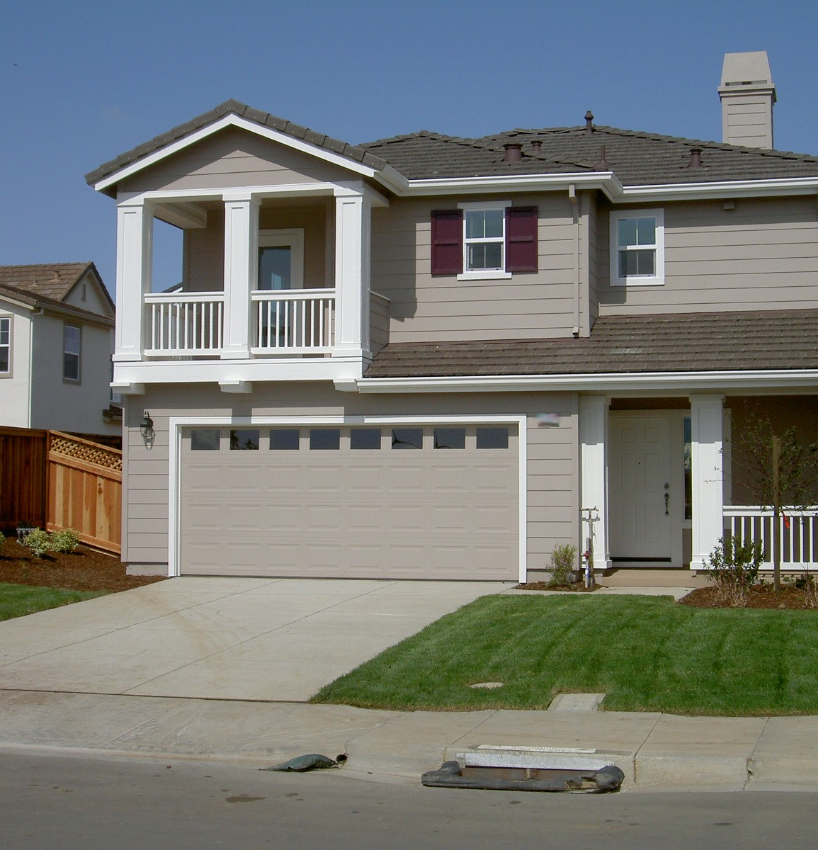
Agenda
Kimley-Horn Approach
Scope of Work
Housing Element Overview
Regional Housing Needs Allocation (RHNA)
Summary of Candidate Sites Strategies
Community Engagement Strategy

Slide 3
Kimley-Horn Approach
Strong interdisciplinary team
“Turn-key” approach
Understanding of the RHNA/HCD processes
Locally-based policy approach

Slide 4
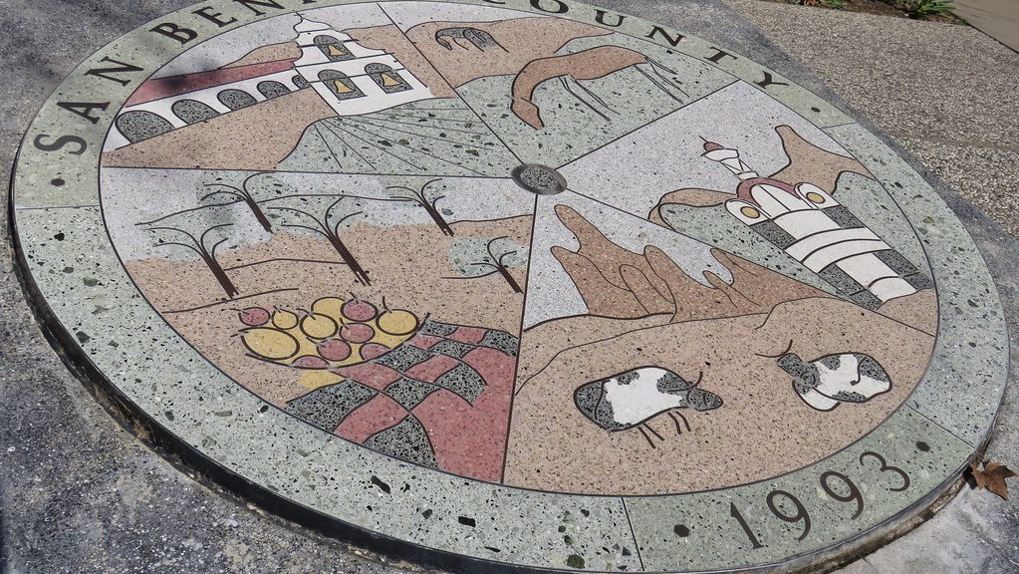
Scope of Work

Slide 5
Scope of Work
Task 1: Project Initiation
Task 2: Analyze Regional Housing Needs Assessment (RHNA)
Task 3: Land Use Strategies – Prototype and Testing
Task 4: Other General Plan Amendments
Task 5: CEQA Compliance
Task 6: Drafting Housing Element
Task 7: Plan Adoption
Task 8: Meetings and Project Management

Slide 6
Project Initiation
Project Kick-Off Meeting
Kick-off meeting to discuss the update process, answer questions, provide data, and exchange other important procedural aspects of the Housing Element Update. The meeting will address the following:
Review/Modify Scope of Work and Schedule
Define Outreach Methodologies
Data Sharing/Exchanging
Meetings and public Engagement

Slide 7
Tentative Project Schedule

Slide 8
Tentative Project Schedule
Kick-Off Meeting and Revising Project Schedule
June 2023
Begin Assessing Current Housing Element
June 2023
Administrative Review Draft October-December 2023
Public Review Draft December 2023 – January 2024
Virtual Community Workshop # 1 August 2023
PC/CC Study Session December 2023
HCD Submittal Draft
February 2024
Virtual Community Workshop #2
December 2023 – January 2024

Slide 9
Housing Element Overview

Slide 10
What is a Housing Element?
Required Chapter of the jurisdiction’s General Plan
Identifies projected housing needs by income category
Provides goals, policies, programs, and quantified objectives to address current needs and guide future housing growth for all income levels
Requires timely certification by the Department of Housing and Community Development (HCD) for compliance with State laws

Slide 11
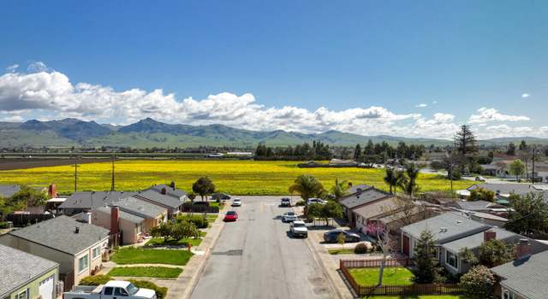
Why are Housing Elements Updated?
Ensures the Housing Element is compliant with State housing laws
Establishes a plan for meeting the housing needs of all income levels
Demonstrates the County’s ability to meet current and future housing growth needs
Engages the community in the planning process

Slide 12
Housing Element Certification
What is a “Certified” Housing Element?
Reviewed and certified by the Department of Housing and Community Development (HCD)
Benefits of Certification
Provides access to State grants and alternative funding sources
Demonstrates compliance with State law
Protects County from penalties

Slide 13
Housing Element Components
Section 1: Introduction
Section 2: Community Demographic Profile
Section 3: Analysis of Housing Constraints, Resources, and Fair Housing
Section 4: Housing Plan
Appendix A: Review of Past Performance
Appendix B: Adequate Sites Analysis
Appendix C: Summary of Community Engagement
Appendix D: Glossary of Housing Terms

Slide 14
Housing Element Components
Section 1: Introduction
Section 2: Community Demographic Profile
Analysis of the County’s population, household and employment base, and the characteristics of the housing stock
Section 3: Analysis of Housing Constraints, Resources, and Fair Housing
Governmental and nongovernmental constraints, affordability of housing, housing resources, as well as the Affirmatively Furthering Fair Housing (AFFH) section
Section 4: Housing Plan
Identified housing needs, including housing goals, policies, and programs

Slide 15
Appendices
Appendix A: Review of Past Performance
Housing Plan progress is reported annually to the State through Annual Progress Reports (APRs)
Appendix B: Adequate Sites Analysis
Identified sites and strategies to accommodate the 2023-2031 RHNA of 754 housing units
Appendix C: Summary of Community Engagement
Appendix D: Glossary of Housing Terms

Slide 16
Regional Housing Needs Allocation (RHNA)

Slide 17
What is RHNA?
Statewide determination of units split into regional allocations
Housing Element Update process initiated
Housing needs within each California jurisdiction quantified by income category
Based on future population, employment, and household growth

Slide 18
Regional Housing Needs Allocation (RHNA)
Approved by SBCOG on October 20, 2022.
The Housing Element must show how the County can accommodate the RHNA. The County is not required to construct the units.
The Housing Element must identify candidate sites to accommodate the County’s 2023-2031 RHNA need.
Candidate sites must be in areas of the County with existing and/or planned resources and infrastructure.
Candidate sites inventory considers:
Zoning capacity and density assumptions.
Projected Accessory Dwelling Unit (ADU) production as pre-approved for SBCOG by HCD
Projects currently in the “pipeline”
Projects with Planning approval
Default densities and capacity assumptions by affordability levels.
“No Net Loss” law and back up sites.
General Plan consistency.

Slide 19
How is RHNA Determined?
Department of Housing and Community Development
HCD determines and distributes the State’s housing need to all the regional councils of government
San Benito County RHNA
2023-2031
754 units
San Benito Council of Governments (SBCOG)
SBCOG develops methodology to determine “fair share” distribution of the region’s housing need to local jurisdictions

Slide 20
RHNA Income Categories
Income Category | % of Area Median Income (AMI) | Income Range* |  | RHNA (Housing Units)
 |  | Minimum | Maximum
Extremely Low Income | 0 – 30% | -- | $31,550 | 123
Very Low Income | 31 – 50% | $31,551 | $52,550 | 123
Low Income | 51 – 80% | $52,551 | $84,100 | 198
Moderate Income | 81 – 120% | $84,101 | $126,100 | 103
Above Moderate Income | >120% | $126,101 | -- | 207
TOTAL: |  |  |  | 754 units
*Income range is based on the 2022 HUD Area Median Income (AMI) for San Benito County of $105,100 for a family of 4.

Slide 21
Summary of Candidate Sites Strategies

Slide 22
Candidate Sites Strategies
Sites and strategies consider:
Access to community resources and services
Infrastructure (water, sewer, and dry utilities)
Access to transportation
Environmental barriers
Utilize vacant and underutilized sites to accommodate as much RHNA as possible
If sites are not available to accommodate expected RHNA growth in the planning period, the County must provide a rezoning program to address unaccommodated need

Slide 23
Candidate Sites Strategies
Candidate sites inventory considers:
Zoning capacity and density assumptions.
Projected Accessory Dwelling Unit (ADU) production as pre-approved for SBCOG by HCD
Projects currently in the “pipeline”
Projects with Planning approval
Default densities and capacity assumptions by affordability levels
“No Net Loss” law and back up sites
General Plan consistency

Slide 24
Community Engagement Strategy

Slide 25
Community Engagement Strategy
Community engagement tailored to San Benito County
Broad inclusion including those most affected via community stakeholders
Establish the context for informed decision-making
Encourage continual, meaningful, and accessible engagement
Virtual workshops
Live polling tools
Online platforms and surveys
Multi-lingual efforts / Complete translation services

Slide 26
Community Engagement
Community Workshop #1 - Introduction and Policy Considerations – August 2023
Stakeholder Workshop - Fair Housing – August-October 2023
Community Workshop #2 - Land Use Strategies and Housing Policies – Dec 2023 or Jan 2024
Joint Planning Commission and Board of Supervisors Study Session – Dec 2023 or Jan 2024
Planning Commission Public Hearing – TBD
Board of Supervisors Public Hearing – TBD
Ongoing Outreach to the Community
Flyers
Email blasts
Community Survey

Slide 27
Community Workshop #1 - Introduction and Policy Considerations
Community workshop via Zoom to discuss the Housing Element update process
Kimley-Horn will prepare all noticing materials (e.g., flyer, web notice, etc.), in both English and Spanish and provide translation services in a Zoom “breakout room” as part of the workshop
Kimley-Horn will prepare and deliver a PowerPoint presentation, informational handouts, visual aids, and other materials.
Participants will identify challenges, issues, and opportunities for the Housing Element

Slide 28
Stakeholder Workshop
Kimley-Horn will facilitate a workshop focusing primarily on Fair Housing related issues to address the requirements to Affirmatively Further Fair Housing through the identification of issues, challenges, contributing factors and opportunities related to fair housing in the County
The workshop will primarily be focused on hearing from agencies, services providers, and advocacy groups who have a presence in the County
It is assumed the County will assist in the identification of appropriate participants

Slide 29
Community Workshop #2 - Land Use Strategies and Housing Policies
Results of the alternative land use strategies and initial draft housing policy plan will be compiled into a Land Use Strategies and Policy Report.
A PowerPoint presentation summarizing this report will be presented at a second community workshop via Zoom.
Kimley-Horn will prepare a draft and final PowerPoint for review by the County prior to the meeting.
Kimley-Horn will prepare all noticing materials (e.g., flyer, web notice, etc.), in both English and Spanish and provide translation services in a Zoom “breakout room” as part of the workshop
It is assumed the County will assist in the dissemination and distribution to residents and stakeholders.

Slide 30
Joint Planning Commission and Board of Supervisors Study Session
Kimley-Horn will prepare for and help facilitate a Planning Commission or Board of Supervisors study sessions (up to 2 meetings) to review preliminary Land Use Strategies and Policy Report and associated comments received from the public
Kimley-Horn will prepare a draft and final PowerPoint for review by the County prior to these meetings

Slide 31
Board of Supervisors and Planning Commission Public Hearings
Kimley-Horn will participate in-person at one public hearing before the Planning Commission and one public hearing before the Board of Supervisors
Kimley-Horn will prepare and present a PowerPoint presentation, assist in drafting staff report language, and respond to questions at each of the public hearings
Kimley-Horn will prepare all noticing materials (e.g., flyer, web notice, etc.), in both English and Spanish
It is assumed the County will be responsible for the dissemination and distribution of these materials

Slide 32
Ongoing Outreach
Community Housing Survey #1 – Resident and Stakeholder Values and Priorities
Kimley-Horn will create a web-based community survey to identify and evaluate community values and priorities for potential housing, housing goals, policies, and programs
The community housing survey will provide tangible data that can be incorporated into the Housing Element to better understand community and stakeholder interests, help determine land use alternatives, and document the County’s outreach efforts to HCD
Results of the survey will be incorporated into a draft and final baseline report. It will include charts and tables that quantify the survey results, a summary of key findings, and an appendix of all response comments.
Email Blasts
Noticing materials such as flyers, web notices, etc., in both English and Spanish

