Slide 1
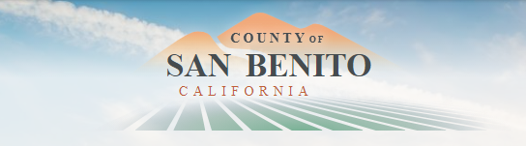
Introduction to Redistricting
Dr. Jeff Tilton, Senior Consultant
National Demographics Corporation

Slide 2
Redistricting Process
Step | Description
Staff Public Hearing September 27, 2021 6:30 p.m. | Held prior to release of draft maps Educate, solicit input on the communities in the Districts
Public Workshops (Locations TBA) | Wednesday, October 6, 1 p.m. Saturday, October 9, 10 a.m. and 2 p.m. Friday, October 22, 4 p.m. Overview of mapping tools; generated data on communities of interest
Census Data Releases | August 12, 2021: Census Bureau releases official 2020 Census population data September 20, 2021: California Statewide Database releases California’s official ‘prisoner-adjusted’ 2020 redistricting data
BOS Public Hearing October 26, 2021 9 a.m. | Held prior to release of draft maps Educate and to solicit input on the communities in the Districts
BOS Public Hearing November 9, 2021 9 a.m. | Discuss draft maps and sequencing Deadline to submit draft maps: October 26, 5 p.m. Posted to website by: November 1, 5 p.m.
BOS Public Hearing November 23, 2021 9 a.m. | Determine final draft map and sequencing; first reading of ordinance Deadline to submit draft maps: November 9, 5 p.m. Posted to website by: November 15, 5 p.m.
September 27, 2021
Dates/locations subject to change
Notes:
Jeff

Slide 3

Redistricting Rules and Goals
1. Federal Laws
2. California Criteria for
Counties
3. Other Traditional Redistricting Principles
Equal Population
Federal Voting Rights Act
No Racial Gerrymandering
1. Geographically contiguous
2. Undivided neighborhoods and “communities of interest”
(Socio-economic geographic areas that should be kept together)
3. Cities and CDPs
4. Easily identifiable boundaries
5. Compact
(Do not bypass one group of people to get to a more distant group of people)
Prohibited:
“Shall not favor or discriminate against a political party.”
Minimize voters shifted to different election years
Respect voters’ choices / continuity in office
Future population growth
Preserving the core of existing districts

Slide 4

Defining Neighborhoods
1st Question: what is your neighborhood?
2nd Question: what are its geographic boundaries?
Examples of physical features defining a neighborhood boundary:
Natural neighborhood dividing lines, such as highway or major roads, rivers, canals and/or hills
Areas around parks or schools
Other neighborhood landmarks
In the absence of public testimony, planning records and other similar documents may provide definition.

Slide 5
Beyond Neighborhoods:
Defining Communities of Interest
1st Question: what defines your community?
Geographic Area, plus
Shared issue or characteristic
  Shared social or economic interest
  Impacted by county policies
Tell us “your community’s story”
2nd Question: Would this community benefit from being “included within a single district for purposes of its effective and fair representation”?
Or would it benefit more from having multiple representatives?
Definitions of Communities of Interest may not include relationships with political parties, incumbents, or political candidates.

Slide 6
Possible Neighborhoods / Communities

Slide 7
Public Mapping and Map Review Tools
Different tools for different purposes
Different tools for different levels of technical skill and interest
  Simple “review draft maps” tool
  Easy-to-use “Draw your neighborhood” tool
  Paper- and Excel-based simple “Draw a draft map” tools
  Powerful, data-rich “Draw a draft map” tool
Whether you use the powerful (but complicated) online mapping tool, Excel, the paper kit, or just draw on a napkin, we welcome your maps!
Notes:
Jeff

Slide 8
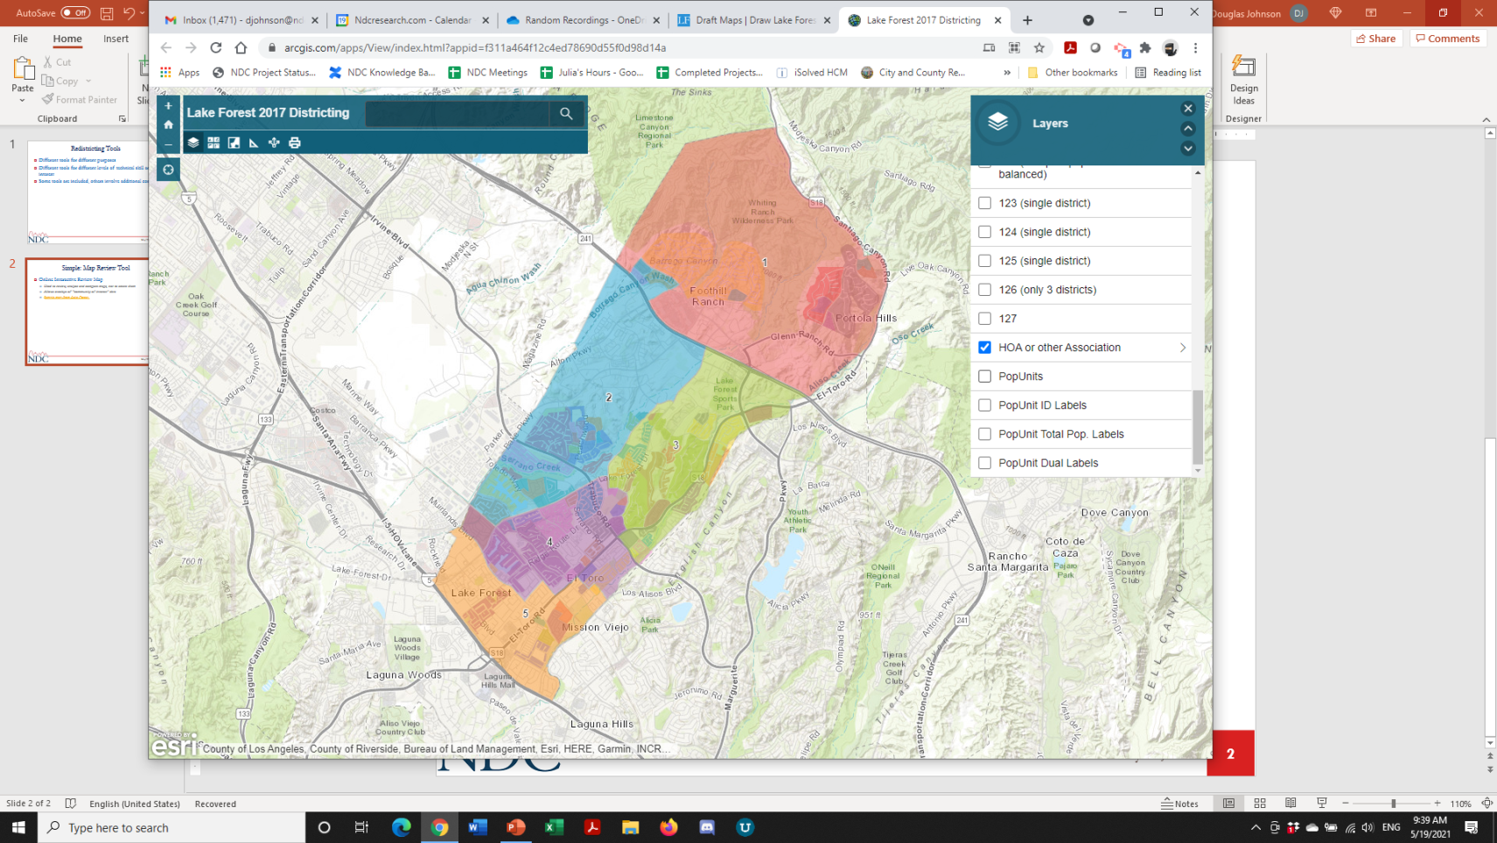
Simple Map Review Tool
Online Interactive Review Map
ESRI’s “ArcGIS Online” – similar to Google Maps in ease of use
Used to review, analyze and compare maps, not to create them
Includes overlays of “community of interest” and other Story Map data
Sample map from Lake Forest

Slide 9
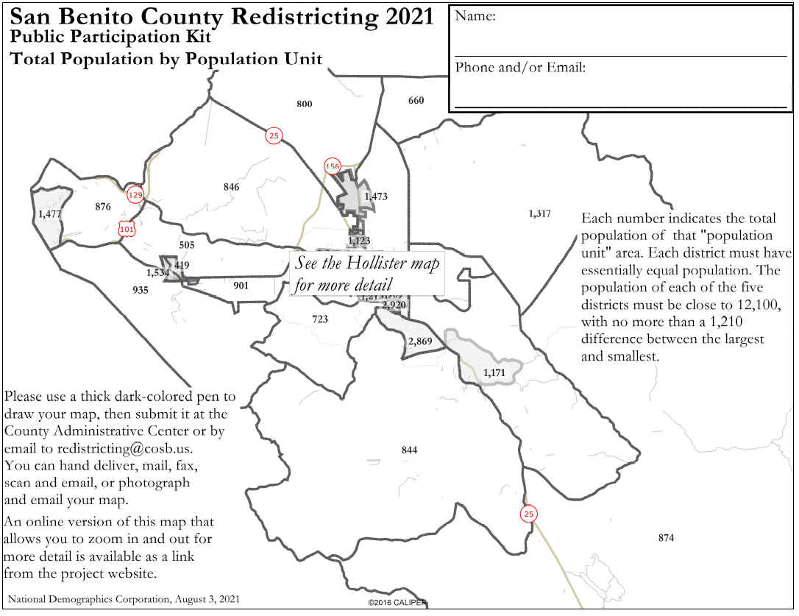
Simple Map Drawing Tool
Paper “Public Participation Kit”
For those without internet access or who prefer paper
Total Population Counts only – no demographic numbers
Geographic units would be tracts, CDP’s and smaller cities

Slide 10
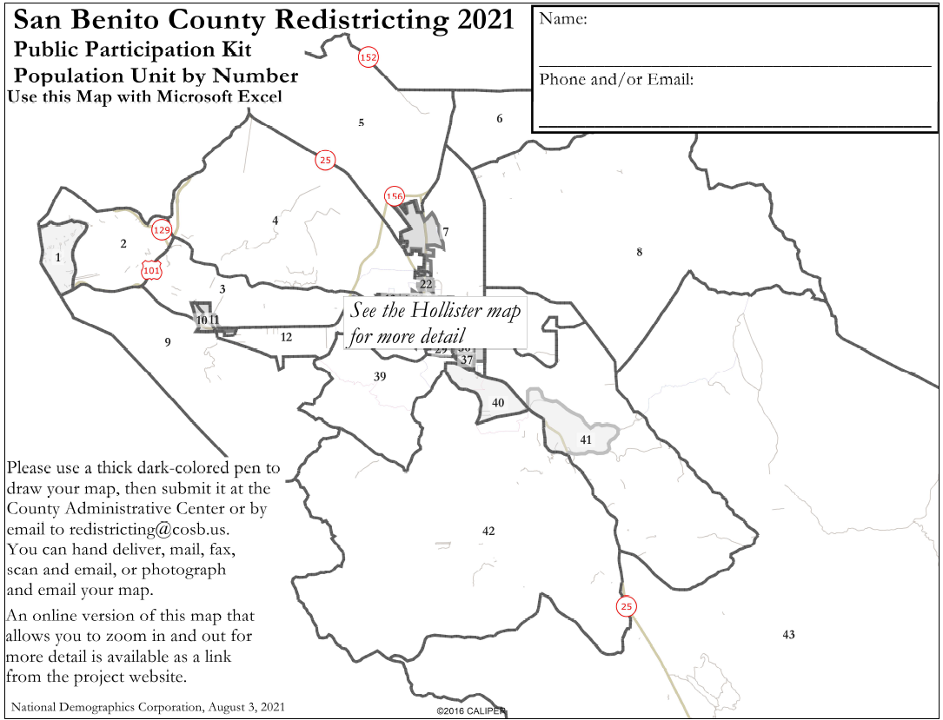
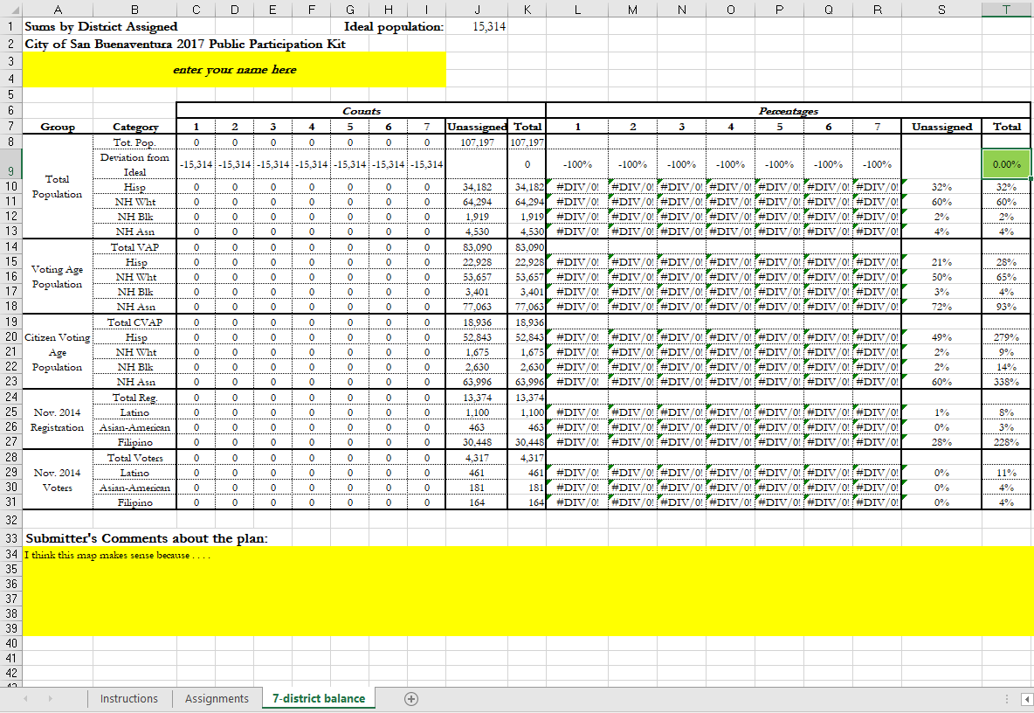
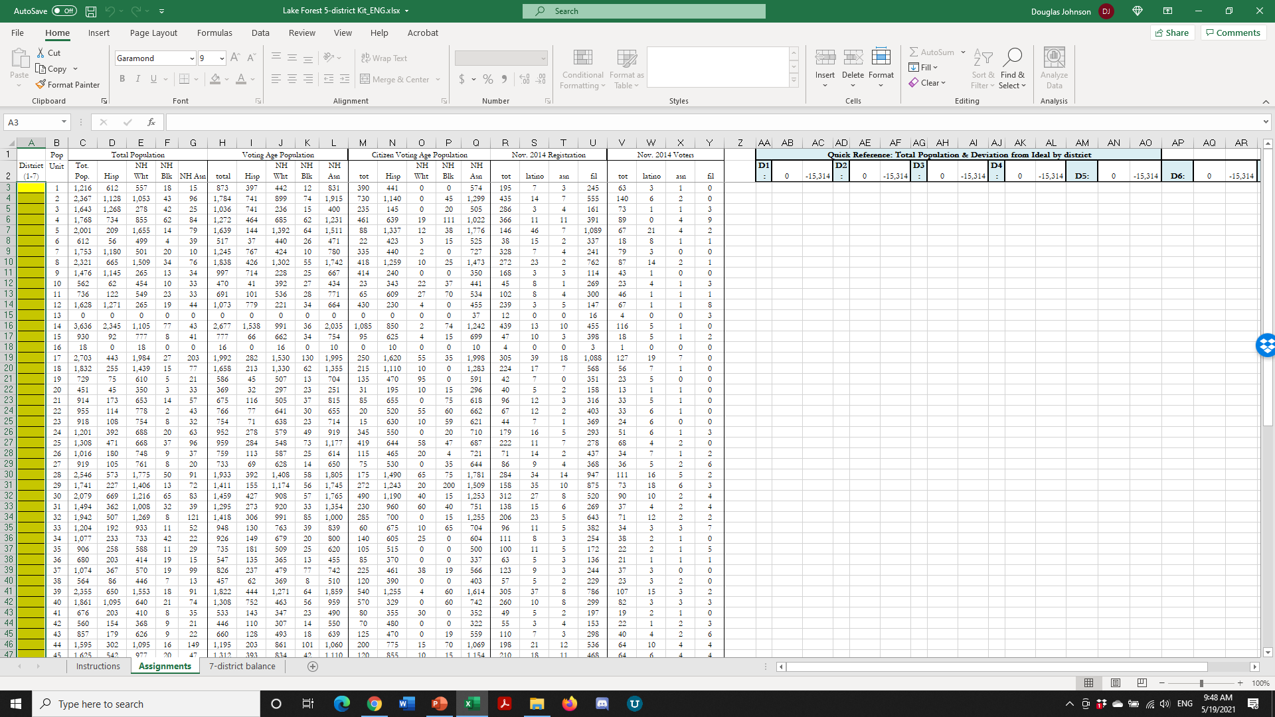
Simple Map Drawing Tool + Excel Supplement
“Public Participation Kit”
For those who know Excel and do not wish to use online tools
Adds CVAP data
Excel does the math
Geographic units would be tracts, CDP’s and smaller cities

Slide 11
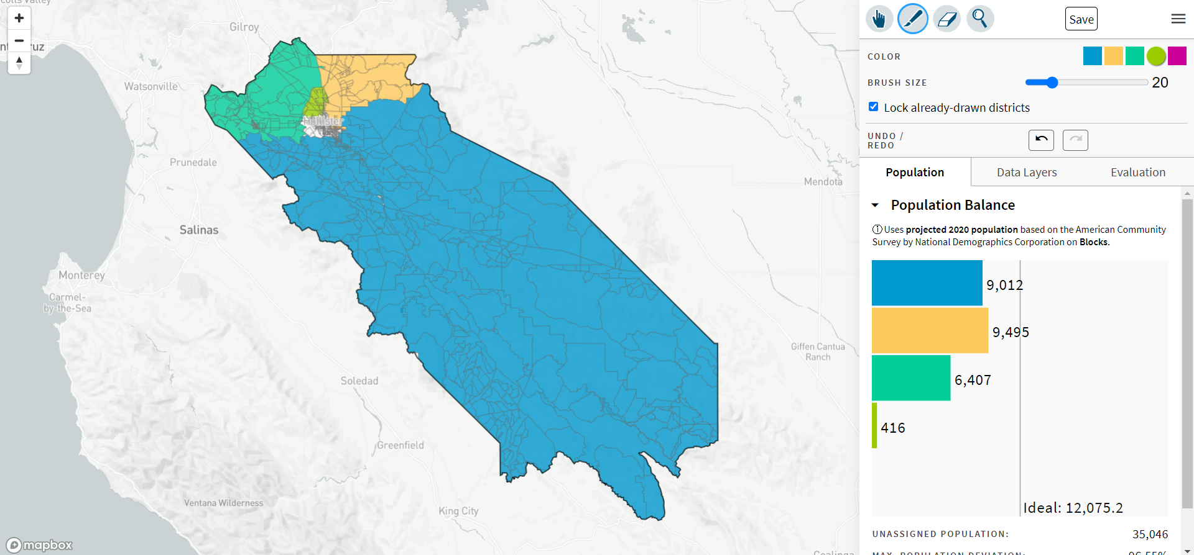
DistrictR
“Draw Your Community of Interest” focus
districtR.org/tag/SanBenito
Also includes simple district-mapping tool; Only available in English
Similar external options: Representable.org, DrawMyCACommunity.org

Slide 12
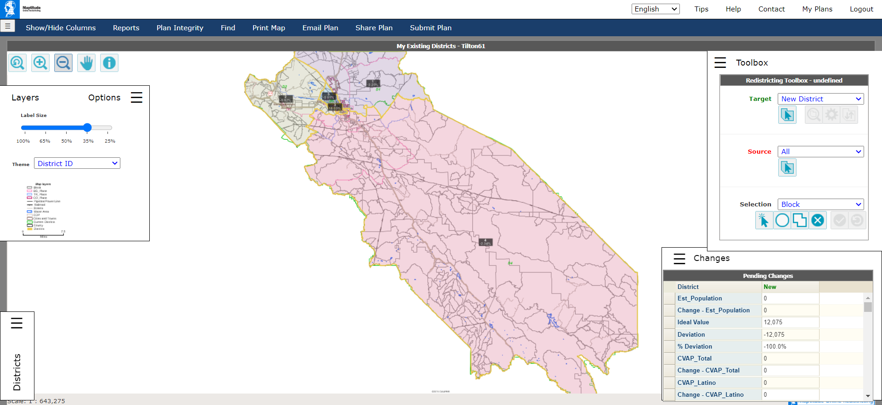
Caliper’s “Maptitude Online Redistricting”
Full Database, Powerful Online Mapping Tool
Powerful, common, data-rich online tool
Six language options: English, Spanish, Portuguese, Vietnamese, Mandarin and Korean

Slide 13

Share Your Thoughts
www.cosb.us/government/county-of-san-benito-board-of-supervisors-bos/supervisorial-redistricting
Redistricting@cosb.us
Notes:
Ryder

Slide 14
Public Hearing & Discussion
What is your neighborhood and what are its boundaries?
What other notable areas are in the County and its cities, and what are their boundaries?
Any questions about the mapping tools?

