Slide 1
Redistricting Boundary and Map Adoption
Dr. Jeff Tilton, Senior Consultant
National Demographics Corporation

Slide 2
Redistricting Process
Step | Description
Staff Public Hearing September 27, 2021 | Held prior to release of draft maps Educate, solicit input on the communities in the Districts
Public Town Halls | Wednesday, October 6, 1 p.m. (California National Guard Armory) Saturday, October 9, 10 a.m. (Immaculate Conception Church) Saturday, October 9, 2 p.m. (Calaveras Elementary School) Friday, October 22, 4 p.m. (San Juan Bautista Community Center) Monday, October 25, 7 p.m. (via Zoom)
Census Data Releases | Census Bureau releases official 2020 Census population data – Aug. 12 California’s official ‘prisoner-adjusted’ 2020 redistricting data – Sept. 21, 27
BOS Public Hearing October 26, 2021 | Held prior to release of draft maps Educate and to solicit input on the communities in the Districts
BOS Public Hearing November 9, 2021 | Discuss draft maps
BOS Public Hearing November 23, 2021 | Determine and Adopt Final map
November 23, 2021
Notes:
Jeff

Slide 3
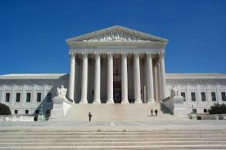
Redistricting Rules and Goals
1. Federal Laws
2. California Criteria for Counties
3. Other Traditional Redistricting Principles
Equal Population
Federal Voting Rights Act
No Racial Gerrymandering
1. Geographically contiguous
2. Undivided neighborhoods and “communities of interest” (Socio-economic geographic areas that should be kept together)
3. Cities and CDPs
4. Easily identifiable boundaries
5. Compact (Do not bypass one group of people to get to a more distant group of people)
Prohibited:
“Shall not favor or discriminate against a political party.”
Minimize voters shifted to different election years
Respect voters’ choices / continuity in office
Future population growth
Preserving the core of existing districts

Slide 4
2020 Census
Ideal population per District: 12,867

Slide 5
Neighborhoods/Communities of Interest
Neighborhoods
What is your neighborhood?
What are its geographic boundaries?
In the absence of public testimony, planning records and other similar documents may provide definition.
Communities of Interest
What defines your community?
Would this community benefit from being “included within a single district for purposes of its effective and fair representation”?
Communities of Interest may not include relationships with political parties, incumbents, or political candidates.

Slide 6
The Maps: November 23, 2021, Public Hearing
Public drafts maps: 6
Compliant maps: 7
Noncompliant maps: 3
Board advanced maps: 1
d71963
Alternative maps based 11.9.2021 Board comments: 3
d79138 (d71963a)
d79142 (d71963b)
d80191 (d71963c) – staff recommended for approval

Slide 7
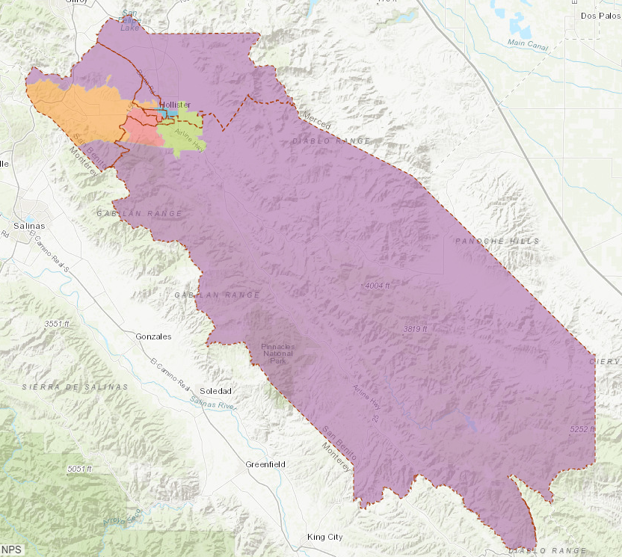
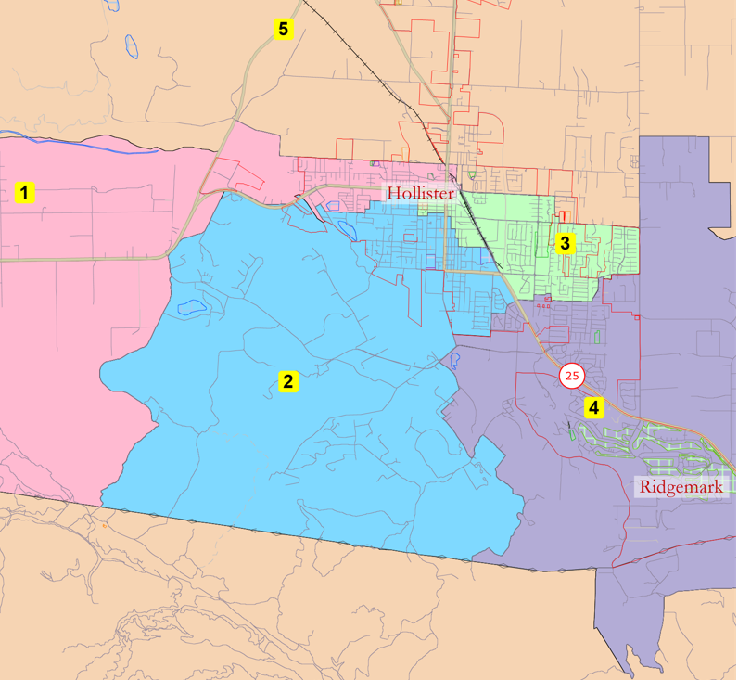
Noncompliant Maps: d57629

Slide 8
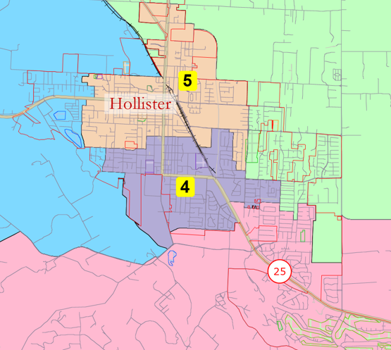
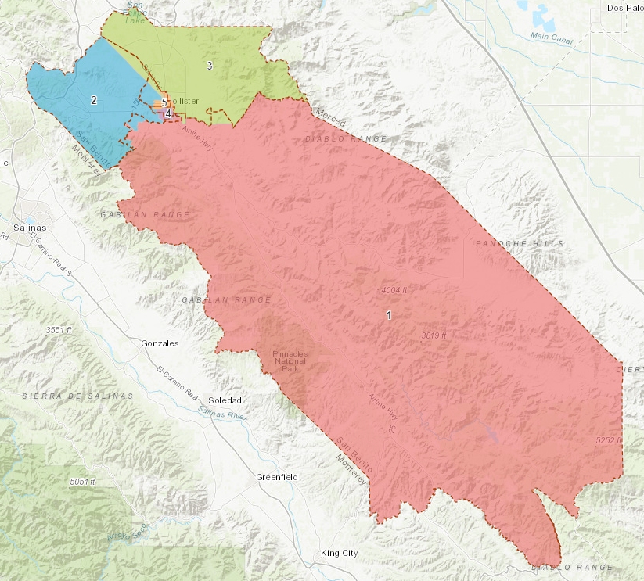
Noncompliant Maps: d57929

Slide 9
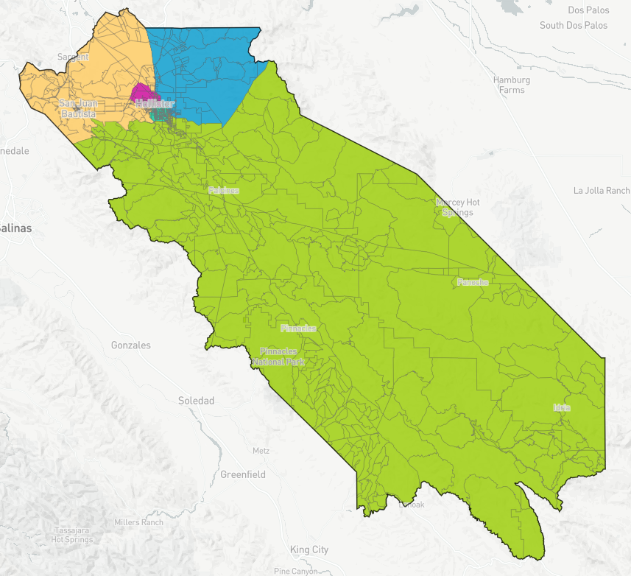
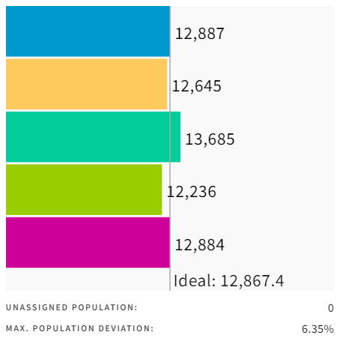
Noncompliant Maps: d79130
Max. Population Deviation = 6.35%

Slide 10
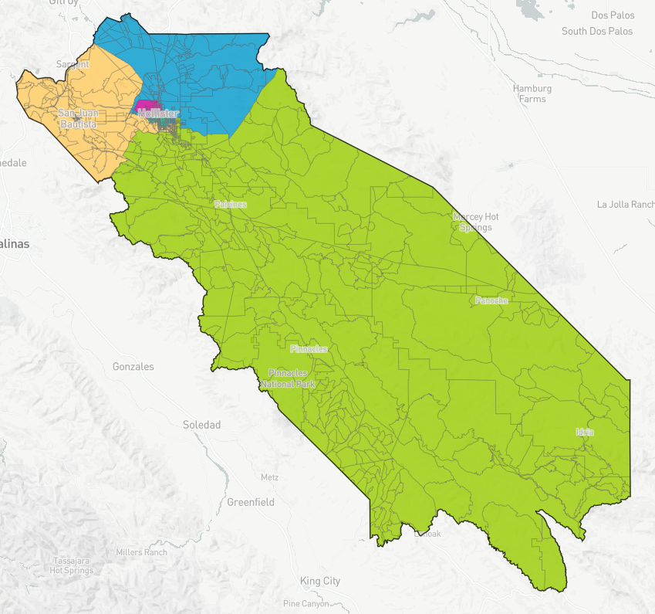
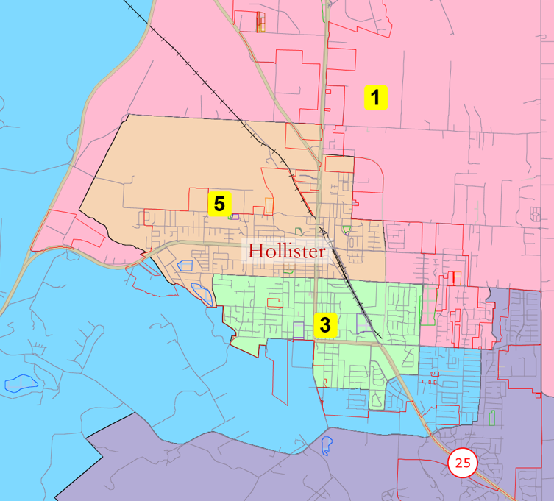
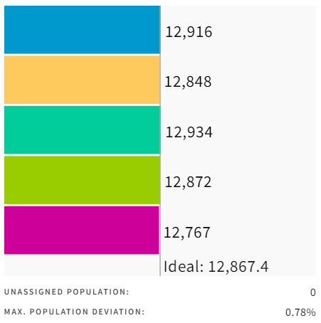
Public Map: d77572
Max. Population Deviation = 0.78%

Slide 11
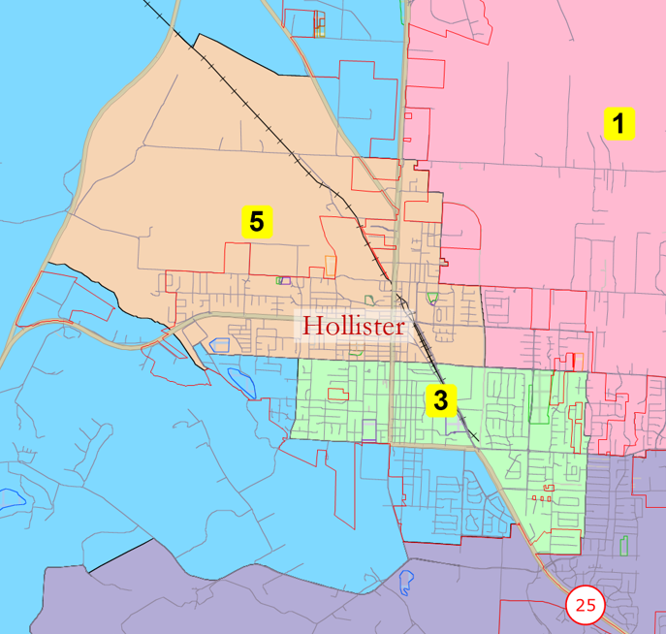
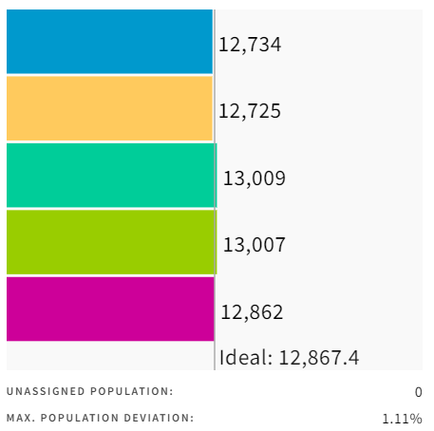
Public Map: d78269
Max. Population Deviation = 1.11%

Slide 12
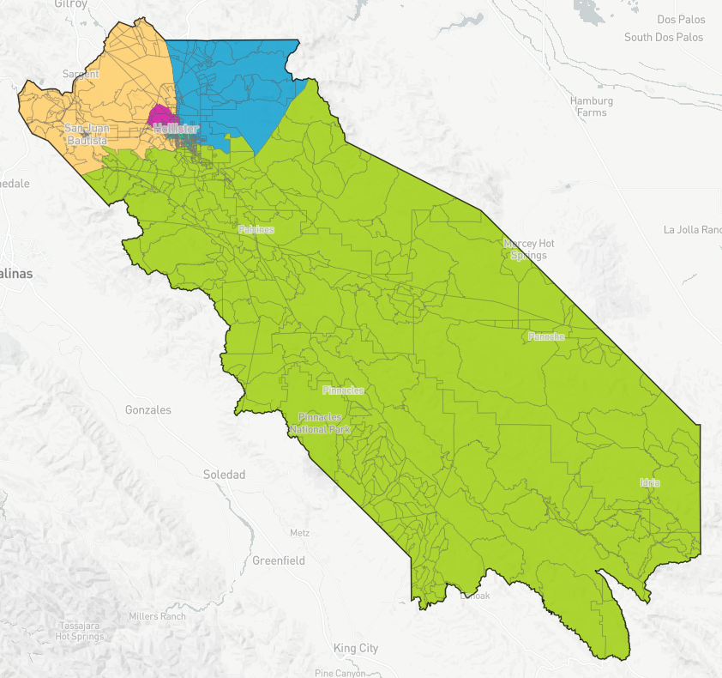
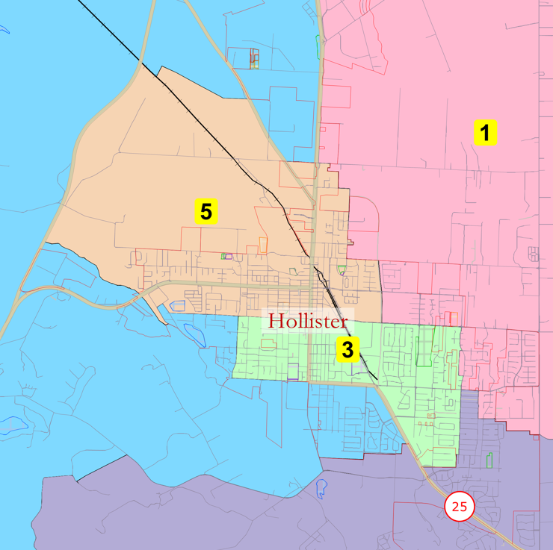
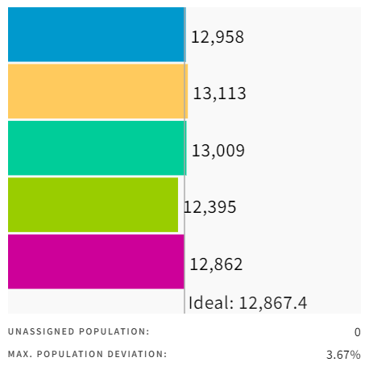
Public Map: d78263
Max. Population Deviation = 3.67%

Slide 13
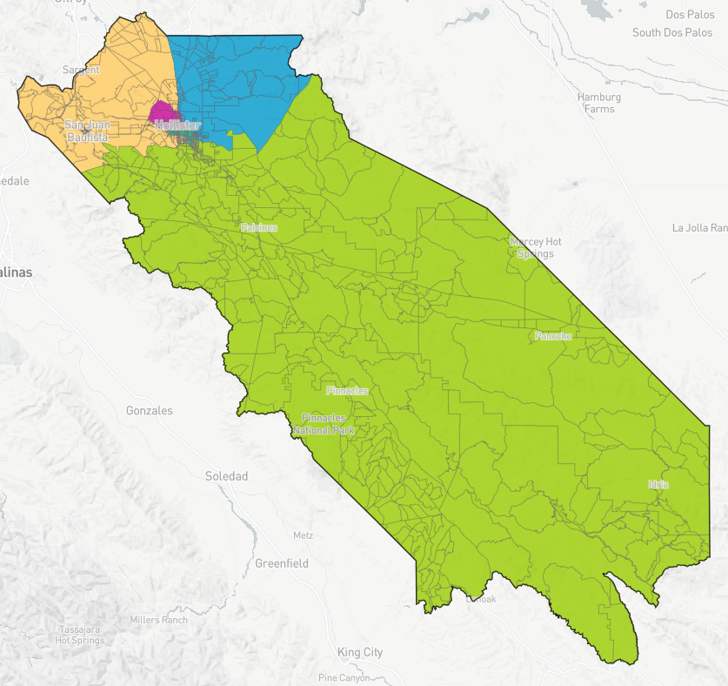
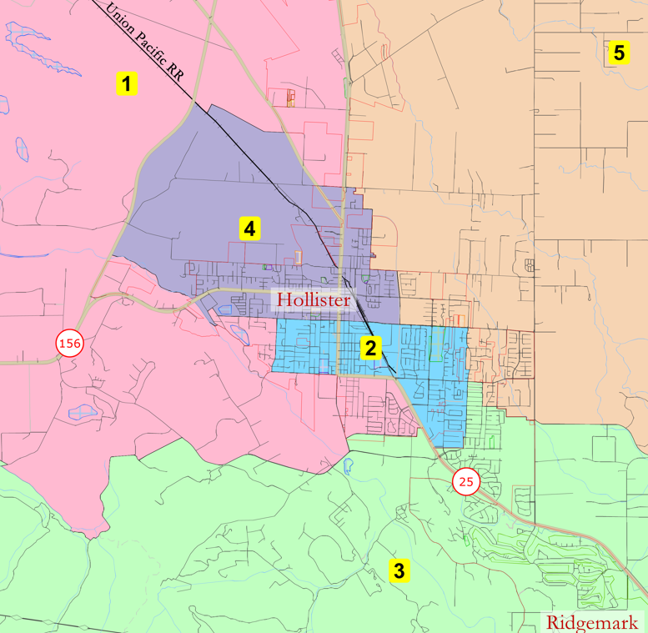
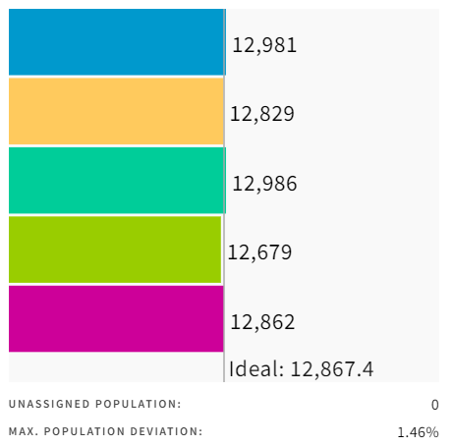
Board Advanced Map: d71963
Max. Population Deviation = 1.46%

Slide 14
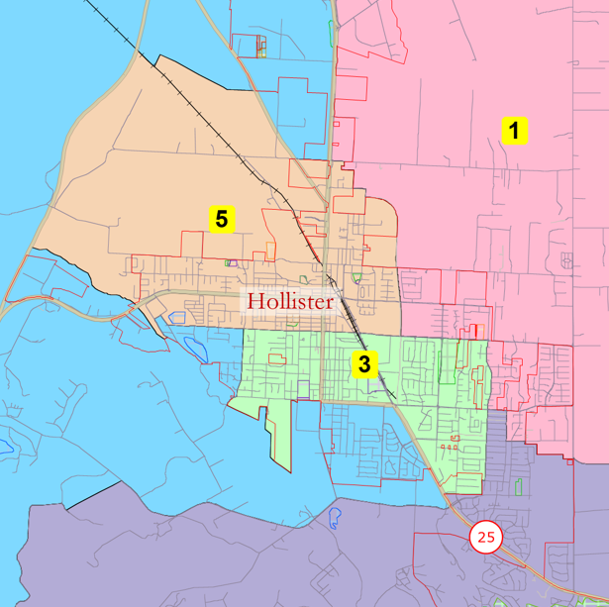
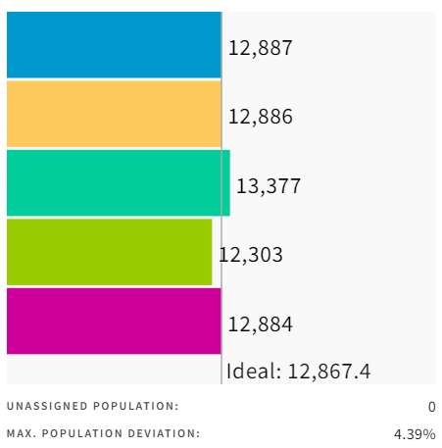
Alternative Map: d79138 (d71963a)
Max. Population Deviation = 4.39%

Slide 15
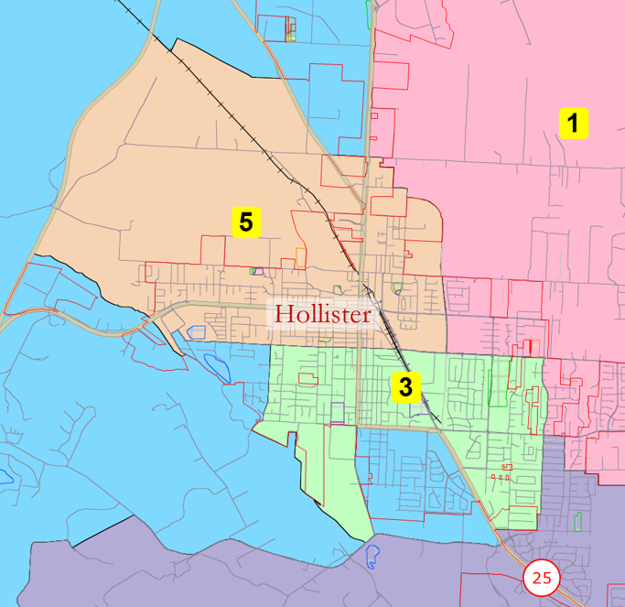
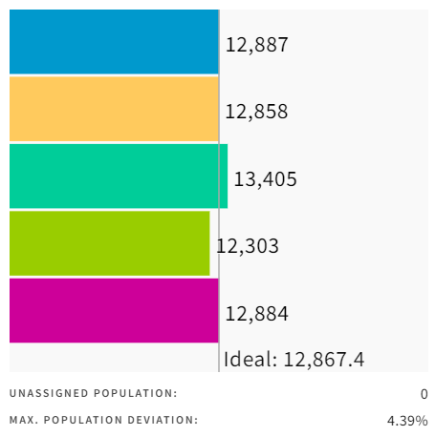
Alternative Map: d79142 (d71963b)
Non-compliant
Max. Population Deviation – 4.39%

Slide 16
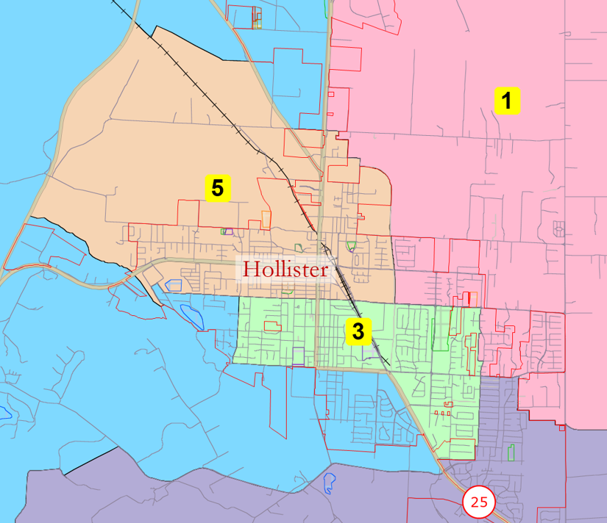
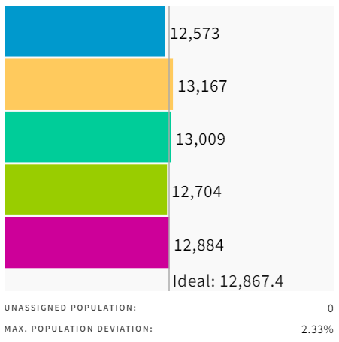
Alternative Map: d80191 (d71963c)
Max. Population Deviation = 2.33%

Slide 17
Public Hearing/Action
Staff Recommendation:
Adopt Resolution adopting d80191 (d71963c) supervisorial district boundaries and map.
Equal population
No gerrymandering
Contiguous
Undivided neighborhoods – communities of interest
Cities & CDPs respected
Easily identifiable boundaries (roads, natural barriers, etc.)
Compact
Preserves core of existing districts

