Slide 1
Keeping Field Workers Safe
Notifications and Field Postings

Slide 2
3CCR 6618: Notice Of Applications
Each person performing pest control shall assure that the operator of the property to be treated receives notice of the scheduled application. The notice must … include:
  (A) The date(s), start time(s), and estimated end time(s) of the scheduled application;
  (B) The location and description of the field to be treated;
  (C) The pesticide product name(s), U.S. EPA registration number(s), and active ingredient(s);
  (D) Spray adjuvant product name(s) and California registration number(s), if applicable;
  (E) The applicable restricted entry interval;
  (F) If the pesticide product labeling requires the posting of treated fields, oral notification, or both; and
  (G) Any other precautions printed on the pesticide product labeling, or included in applicable laws and regulations, related to the protection of employees or other persons during or after application.

Slide 3
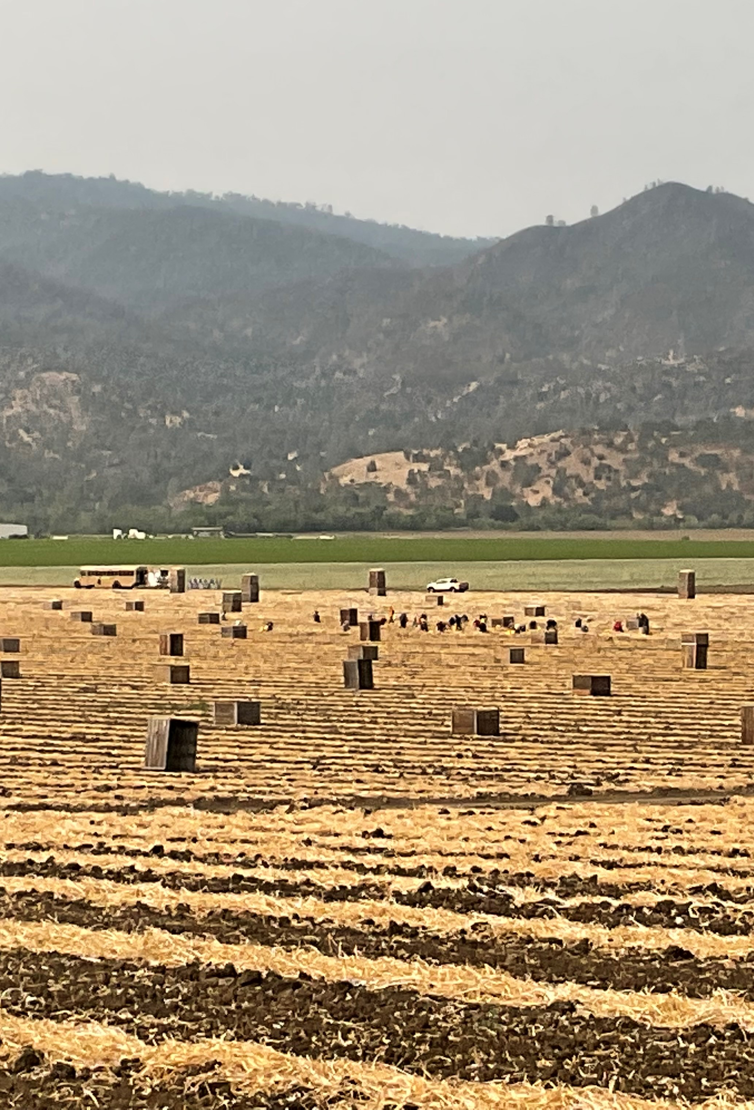
Notification can be orally or in writing
Must be completed prior to the use of any pesticide
Allows sufficient time for required, subsequent notifications
  Property Operator must notify employees working on the property of the scheduled application, including fieldworkers and their employers
  Notice must include:
  The date of the scheduled application;
  The location and description of the field to be treated; and
  Instructions not to enter the field to be treated and its application exclusion zone pursuant to section 6762 until authorized by the operator of the property.

Slide 4
3CCR 6619 Notice of Completed Applications
Any person applying pesticides for the commercial or research production of an agricultural plant commodity shall assure that the operator of the property treated receives notice, orally or in writing, and within 24 hours of completion of the pesticide application. This notice must include the following information:
  The location of the property, including the site identification number, and acreage treated;
  The pesticide product name(s), U.S. EPA registration number(s), and active ingredient(s);
  Spray adjuvant product name(s) and California registration number(s), if applicable;
  The date(s) and time(s) the application started and ended; and
  The applicable reentry and pre-harvest intervals, unless a copy of a written recommendation for the subject application made by a licensed agricultural pest control adviser, properly completed, was given to the operator of the property treated.

Slide 5
CCR 6770 Field Entry After Scheduled or Completed Pesticide Application
The property operator must not allow or direct employees … to enter a field on the date of the scheduled application unless the operator assures that:
  the application has not occurred; and
  the application will not occur during the time the employees are in the field to be treated.
The property operator must not allow or direct employees … to enter a treated field until the operator has received the notice of completion and the restricted entry interval has expired
Notes:
List exceptions

Slide 6
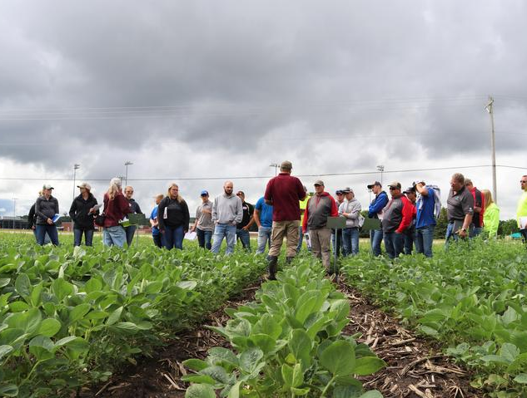
Property Operator must then notify employees working on the property of the completed application, including fieldworkers and their employers. Notification must include:
The location and description of the treated field
The time during which entry is restricted
Instructions not to enter the treated field until the restricted entry interval has expired, except as provided in section 6770.

Slide 7

Exception to Notification Requirements:
Field Posting

Slide 8
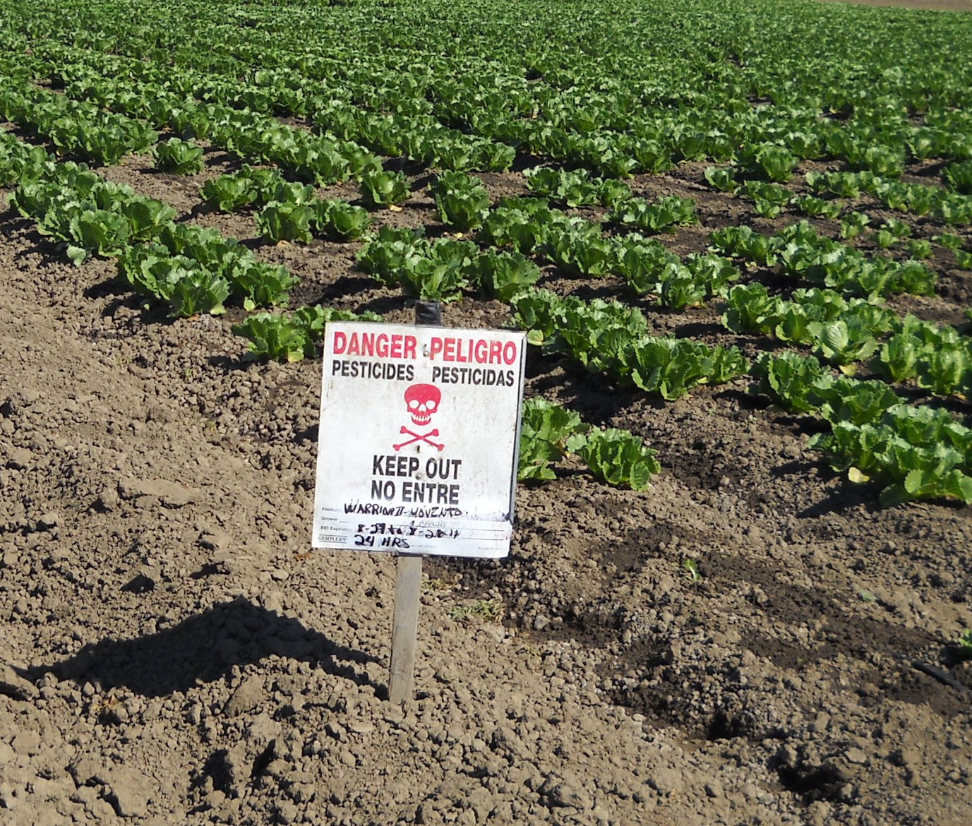
The Use of Field Postings to Comply with 3CCR 6618 and 6619
Notification by the property operator of a scheduled pesticide application or completion is not required to be given to employees (including fieldworkers employed by Farm Labor Contractors) or their employer if the property operator can assure that the field has been posted per section 3CCR 6776 (b-f)
Unless the label of the pesticide being applied requires both oral notification and posting of the treated field

Slide 9
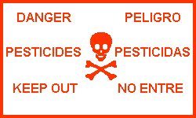
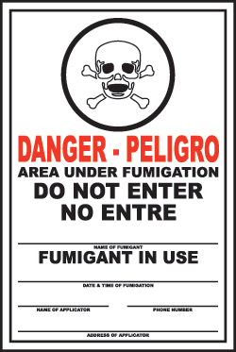
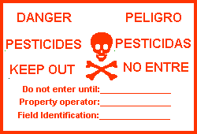
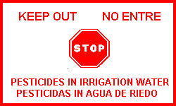
Proper Posting According to 3CCR 6776
1
4
1)When REI is greater than 48 hours
2)When REI is greater than 7 days
3)When “Danger” or minimal exposure pesticide* is applied through irrigation
4)When a fumigant is applied
2
3
*Minimal exposure pesticides (3CCR 6790): bromoxynil (Buctril, Bronate), folpet, oxydementon-methyl (Metasystox-R), propargite (Omite, Comite)

Slide 10
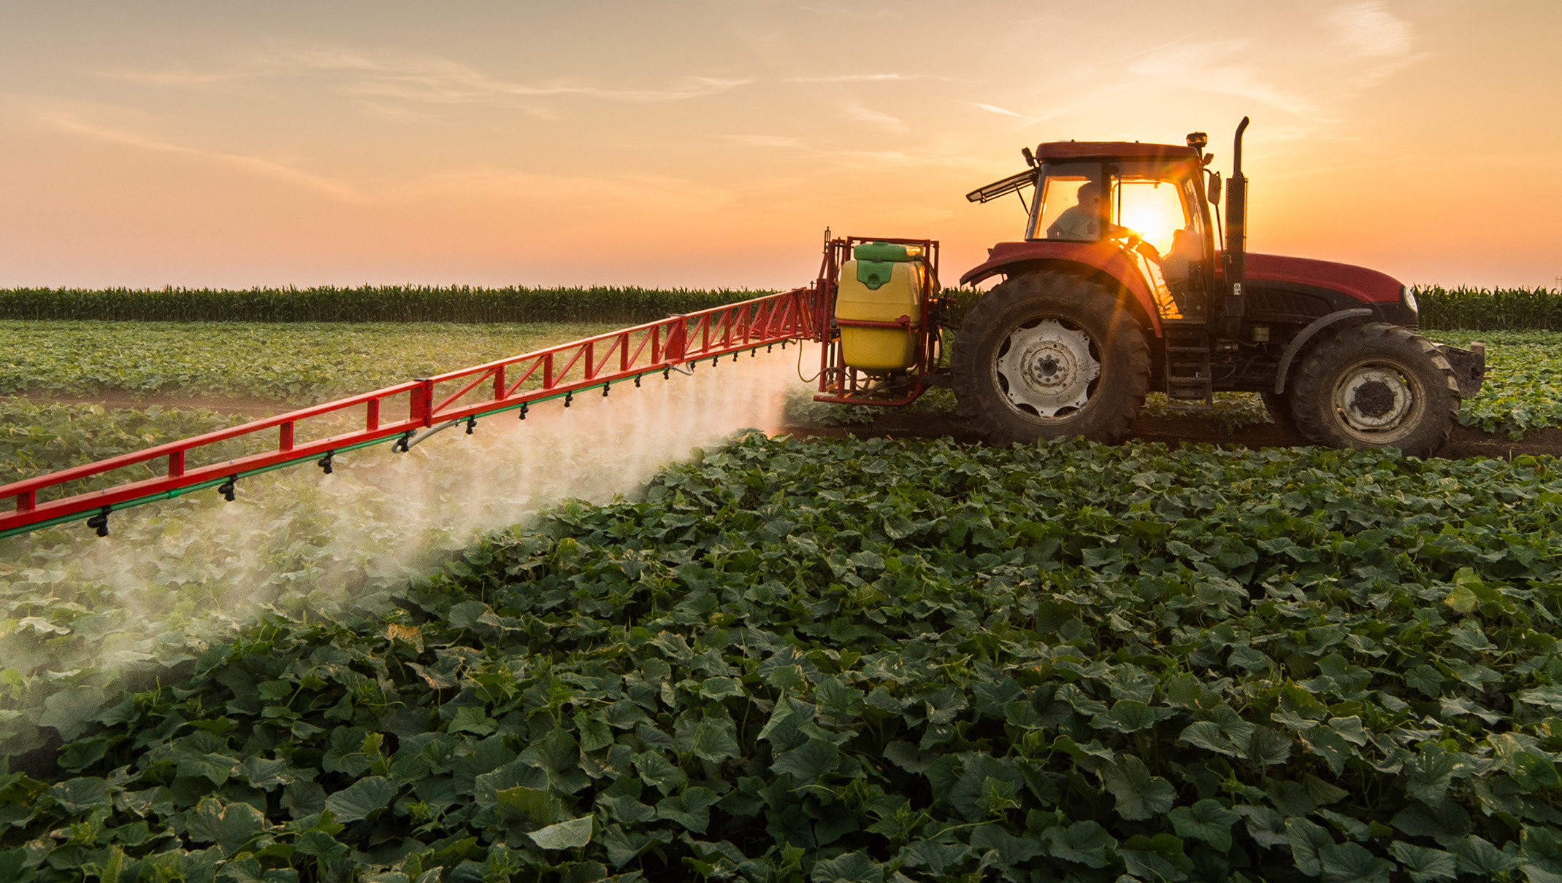
Post signs up to 24 hours BEFORE application begins until the end of the REI
Post so that they are visible at all usual points of entry. If there are no identified points of entry, then post the corners of the field.
Post at each border with any labor camp
If the field borders an unfenced right of way, post at each end of the field and at 600 ft intervals along the border.

Slide 11
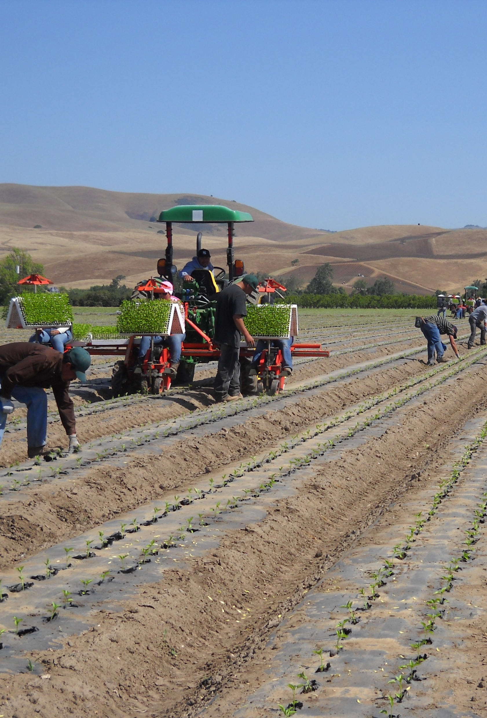
Signs must be removed within 3 days after the end of the Restricted Entry Interval (REI).
Signs must be removed before allowing any fieldworker entry back into the field for activities which were prohibited during the Restricted Entry Interval (REI).

Slide 12
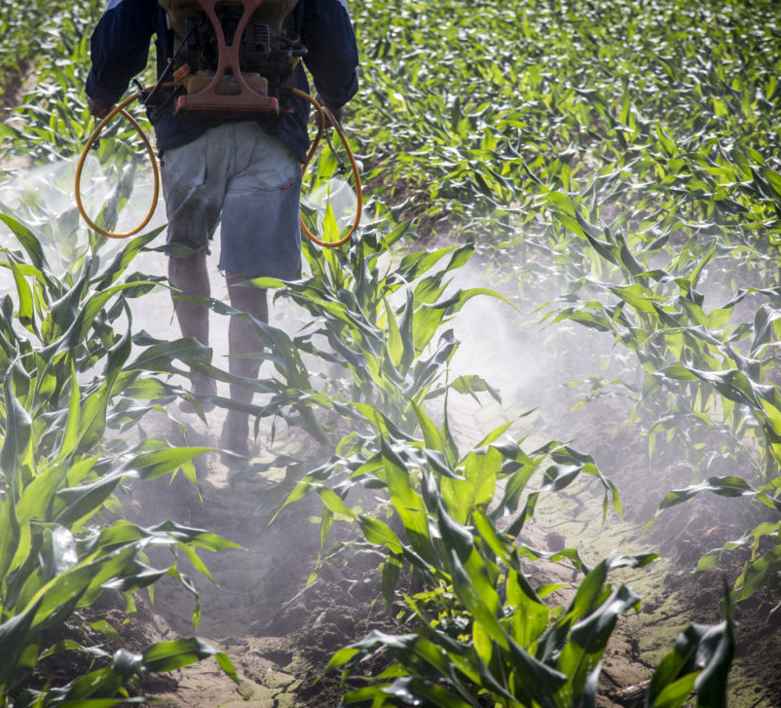
CCR 6720 Safety of Employed Persons is the Responsibility of the Employer

Slide 13
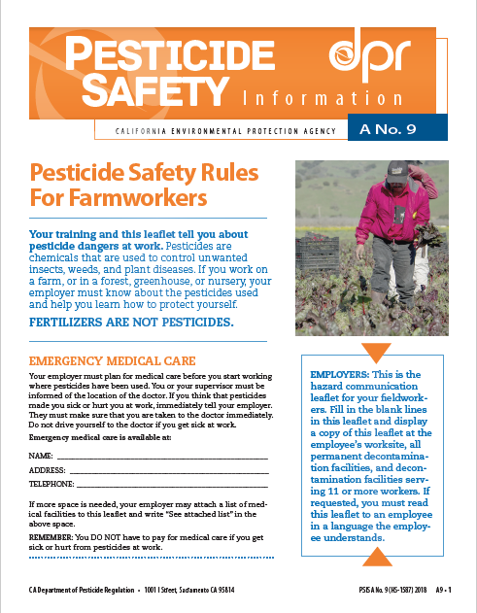
CCR 6761 Hazard Communication for Fieldworkers
Whenever employees are working as fieldworkers in a treated field, the employer is required to display a completed written Hazard Communication Information for Employees Working in Fields (Pesticide Safety Information Series leaflet A-9) at the following locations:
  At the worksite or a central location where the employees start their day
  At all permanent decontamination facilities
  At any decontamination facilities that service 11 or more fieldworkers
Notes:
If there are any changes to the medical information listed in the A-8, the A-8 must be updated to reflect those changes within 24 hours of the change
Upon an employee’s request, the employer must read the PSIS A-8 in a language the employee can understand

Slide 14

Growers must maintain at a central workplace location which is accessible to employees, including FLC employees, pesticide use records and SDS for all pesticides applied within the last 2 years
All fieldworkers, including FLC employees, must be notified of where to find these records prior to entering a treated field

Slide 15
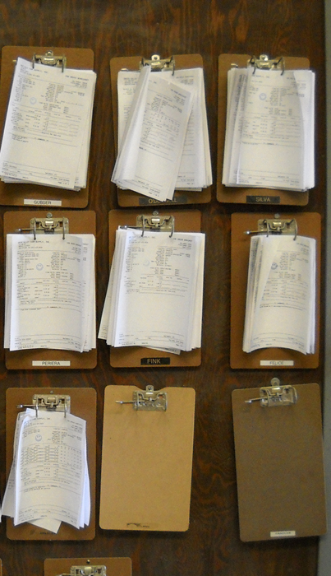
Application-specific Information for Fieldworkers
The operator of property used for the commercial or research production of an agricultural plant commodity shall display at a central location the following application-specific information, while fieldworkers are employed to work in treated fields on the operator's property:
The crop or site treated and identification of the treated field;
The date(s) and time(s) the application started and ended;
Restricted entry interval;
Product name(s), U.S. EPA registration number(s), and active ingredient(s);
A copy of the Safety Data Sheet(s) for the applied pesticide(s); and
Spray adjuvant product name(s) and California registration number(s) if applicable.
Notes:
Growers must display application specific information when they receive notice of a completed application and before any fieldworkers are allowed to enter the treated field
The information must be displayed until the field is no longer considered treated

Slide 16
Summary
There’s a lot of notification that needs to be done; from pest-control businesses to growers, from growers to employees and farm labor contractors and FLC employees
Notification requirements and risk to fieldworkers can be reduced by properly posting treated fields

Slide 17

Questions?

