Slide 1

Assembly Bill No. 481
AB 481, Law Enforcement and state agencies: military equipment: funding, acquisition, and use.
Facilitated by
Sheriff Eric Taylor
Lieutenant Silvestre Yerena
Tuesday August 2nd, 2022, 5:30-7:30 pm

Slide 2

Agenda:
Why Assembly Bill AB 481
How AB 481 defines military equipment
Why equipment is needed
How equipment is funded, acquired, used
San Benito Sheriff’s Office equipment inventory
Community engagement activities
Questions and answers

Slide 3
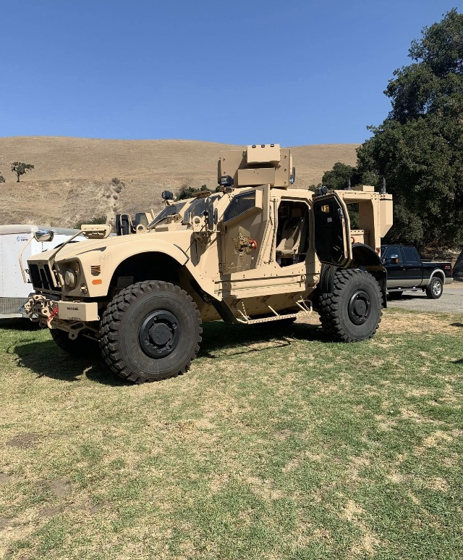
Why AB 481
September 30, 2021- Gov. Newsome signed 8 police reform bills, including AB 481
Increase transparency, accountability, oversight for acquisition and use of equipment
Provide safeguards to protect public’s welfare, safety, civil rights and liberties
Requires an annual report summarize (equipment usage and updates, document internal audits and summarize community feedback).
Create public forum for input and engagement

Slide 4

Why do we need this equipment?
Goal: Safe, peaceful resolutions for the involved parties, the public and officers.
Concerns: Actions, capabilities and intentions
Factors that influence sound decisions: Time, distance and cover

Slide 5
Critical Incidents in San Benito County
09/09/2020 @ 1748 hours, Churchill Road Shooting Incident, 1 person injured. MRAP was used.

Slide 6
Equipment Categories per AB 481
Power aircraft with crew aboard, such as airplane, that use a fixed wing for lift
Powered aircraft with a crew aboard that use a rotary wing lift, such as a helicopter
Unmanned, remotely piloted, powered aerial or ground vehicles

Slide 7
Equipment Categories per AB 481
Cont.
- Wheeled armored vehicles that are either built or modified to provide ballistic protection to their occupants, including a mine-resistant ambushed protected (MRAP) vehicle or an armored personnel carrier.
Wheeled tactical vehicles that are either built to operate both on road and offroad in supporting military operations, such as a high mobility multipurpose wheeled vehicle (HMMWV), commonly refer to as a Humvee, a two and one-half-ton truck, a five-ton truck, or have breaching or entry apparatus attached

Slide 8
Equipment Categories per AB 481
Cont.
Tracked armored vehicles that provide ballistic protection to their occupants and utilize a tracked system instead of wheels for forward motion.
- Command and control vehicles that are either built or modified to facilitate the operational control and direction of public safety units.
Weaponized aircraft, vessels, or vehicles of any kind.
- Breaching apparatus designed to provide rapid entry into a building or through a secured doorway, including equipment that is mechanical, such as a battering ram, ballistic, such as a slug, or explosives in nature.

Slide 9
Equipment Categories per AB 481
Cont.
Firearms of .50 caliber or greater
Ammunition of .50 caliber or greater
- Specialized firearms and ammunition of less than .50 caliber, other that service weapons and ammunition of less than .50 caliber that are issued to officers, agents or employees of law enforcement agency.

Slide 10
Equipment Categories per AB 481
Cont.
Any firearm or firearm accessory that is designed to launch small, explosive projectiles
Any large knife designed to be attached to the muzzle of a rifle, shotgun, or long gun for purpose of hand-to-hand combat.
Explosives and pyrotechnics, including grenades referred to as flashbang grenades and explosive breaching tools
Riot batons, riot helmets, and riot shields, but excluding service-issued telescopic or fixed-length straight batons

Slide 11
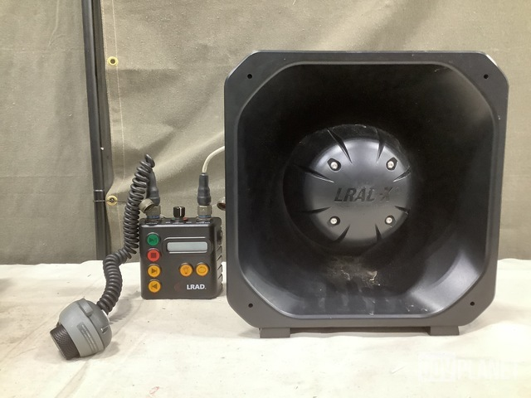
Equipment Categories per AB 481
Cont.
Long-range acoustic devices; and,
Camouflage uniforms, other than uniforms with woodland or desert patterns or solid color uniforms.
-

Slide 12
San Benito Sheriff’s Office Equipment Inventory
- (1) Long Range Acoustic Device (LRAD)
(1) 37mm Kinetic projectile/gas projectile launcher
(5) Shotguns converted to Less Lethal use
Approximately 511 rounds of less lethal shotgun ammunition
(2) Suppressor/Silencer devices
(7) Flash Bang fuses
(3) Reloadable Flash Bang bodies
(4) CS gas grenades

Slide 13
San Benito Sheriff’s Office Equipment Inventory
(12) 37mm CS launchable projectiles
(2) 37mm Kinetic impact munitions
(1) Machine gun (Evidence/training gun)
(14) Weapons that qualify as “Assault Weapons” (Under CA law), Evidence/Training guns
(10) Short barreled rifles (.308’s and SBR’s)
MRAP
Peacekeeper (Bakersfield PD 1033 program)

Slide 14
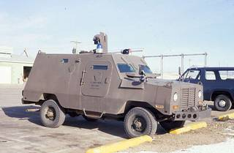
Peacekeeper
Vehicle

Slide 15
How Does this Affect San Benito?
With Board of Supervisors approval of Lexipol Policy 708:
– SBSO will continue to have access to each of the resources currently available. In addition, the corresponding policies and procedures would remain in effect
– Staff will be required to implement a tracking system for equipment use in preparation for the AB 481 Annual Report; this is an increase to existing workload
Without Board of Supervisors approval of Lexipol Policy 708:
– The Department will cease the use of equipment designated by AB 481 as this equipment
– The Department will be required to redesign our policies, procedures and operations for critical incident response; this includes our ability to provide and receive mutual aid
– Public safety will be negatively impacted

Slide 16

Questions, comments and concerns
San Benito Sheriff’s Office
2301 Technology Parkway
Hollister Ca, 95023
831-636-4080

